Slide 1

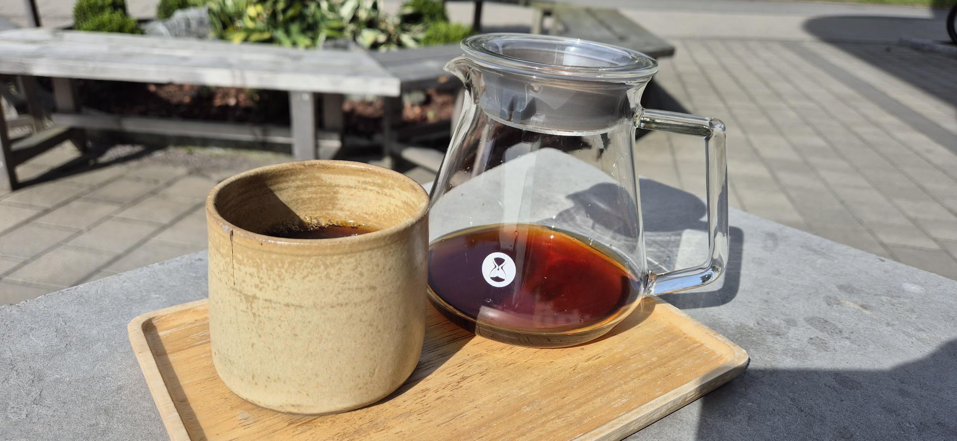






Learning How to Drink Better Coffee
Emanuel Palm Cloud Specialist, Coffee Nerd & Microsoft MVP @ Unwonted
@PalmEmanuel
Notes:
Introduction with a few comments about that it’s crazy that the organizers allowed me to do this presentation when it’s a .NET conference. “Right? Who would’ve thought they wanted a presentation on Java”

Slide 2

Notes:
It doesn’t have to be this way! At least for coffee, I can’t promise anything about the code. Especially if you decided to visit a session on Java.

Slide 3
My Coffee Journey
2020
ENJOYED COFFEE FOR THE FIRST TIME

Slide 5
My Coffee Journey
POWERSHELL CONFERENCE EUROPE 2023
2020
2023
2023
ENJOYED COFFEE FOR THE FIRST TIME
BOUGHT A COFFEE ROASTER
SWEDISH SPECIALTY COFFEE CAMP

Slide 6
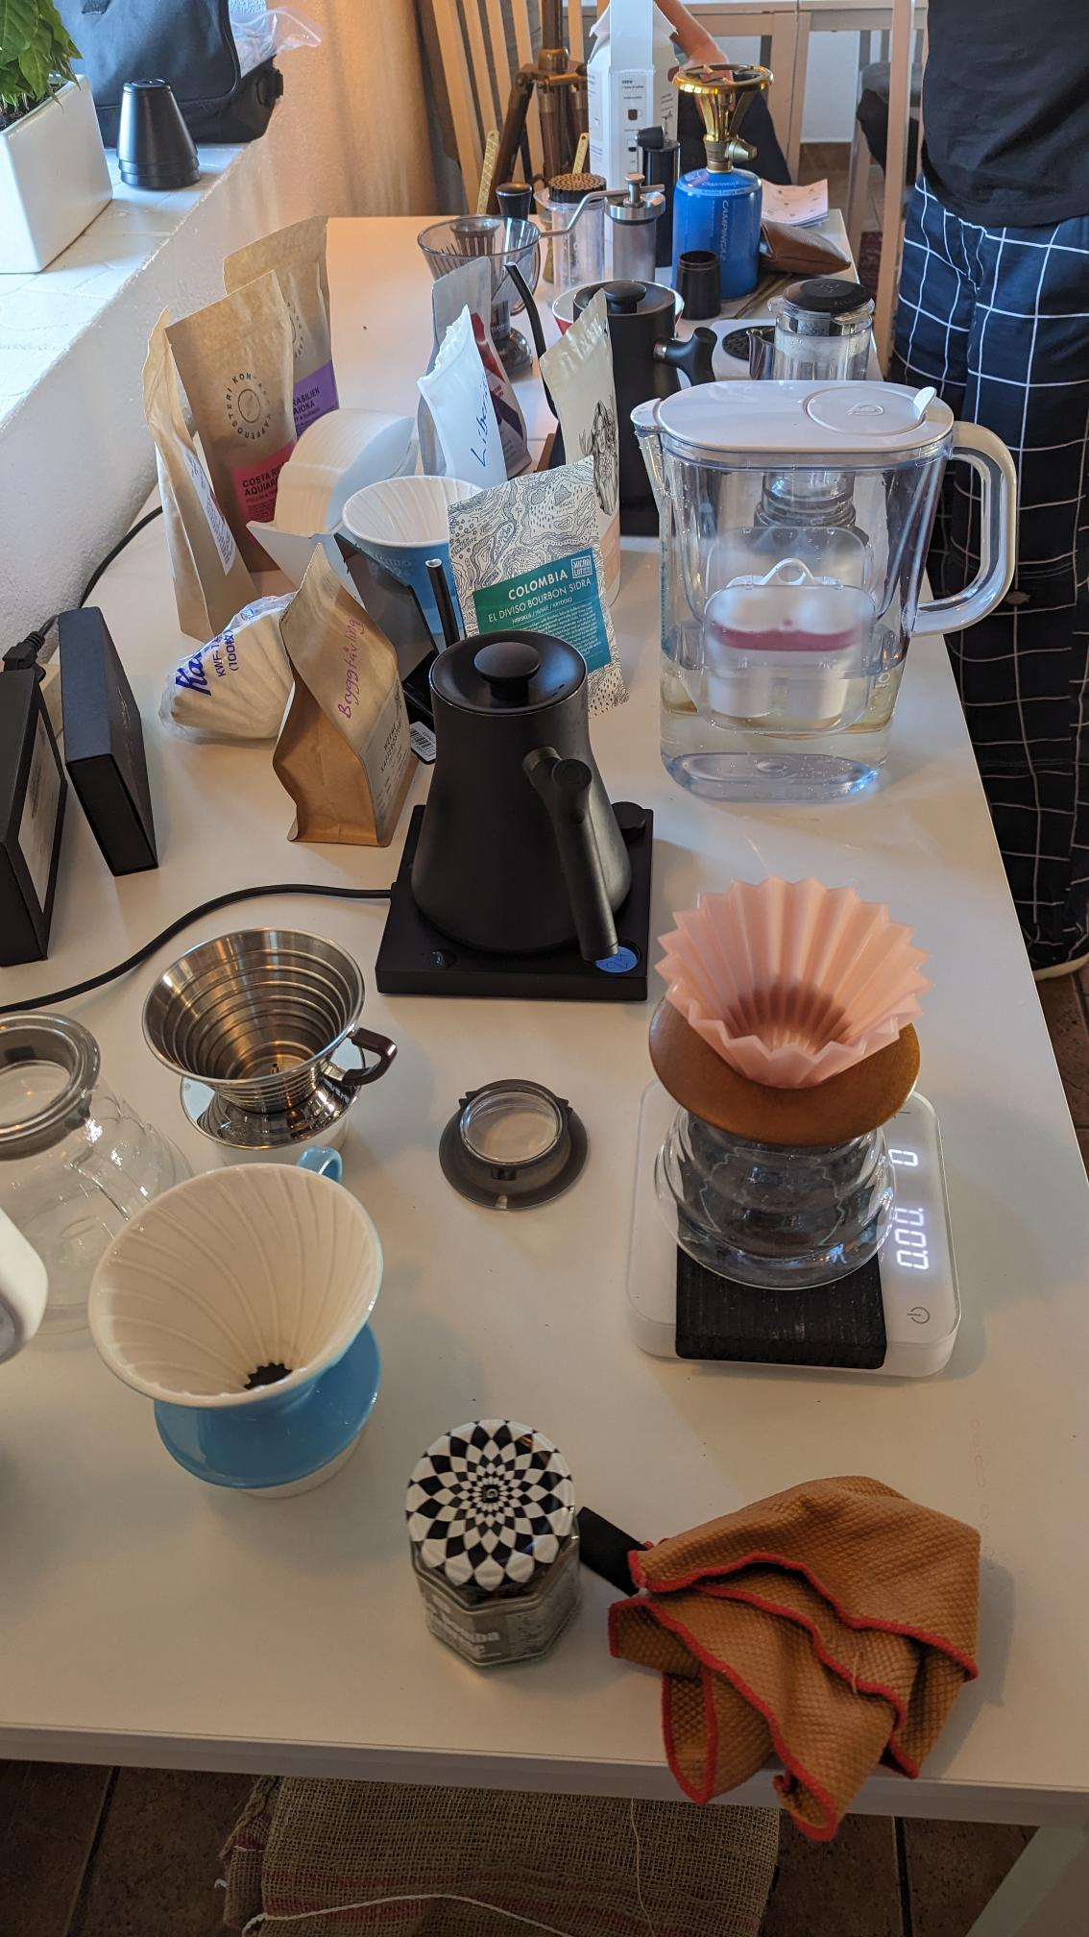
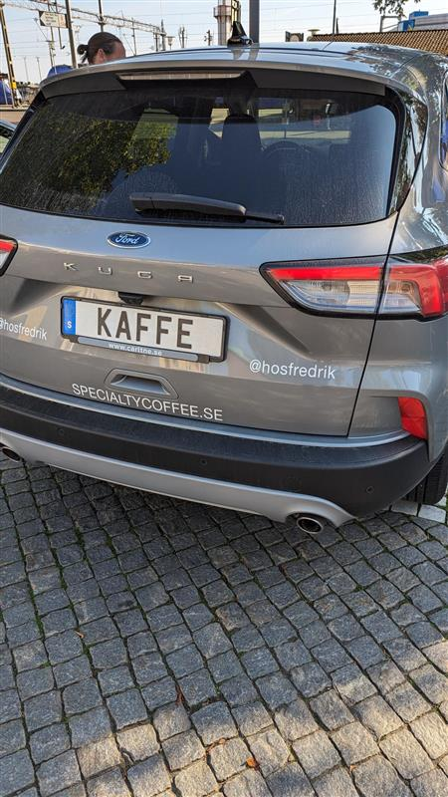
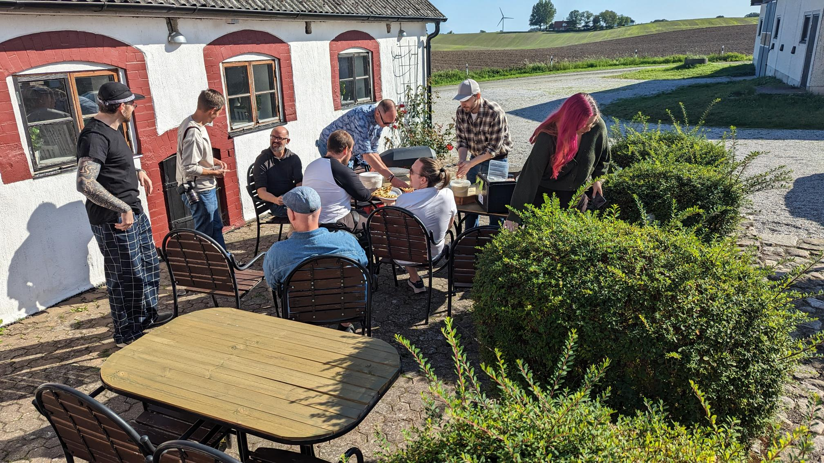
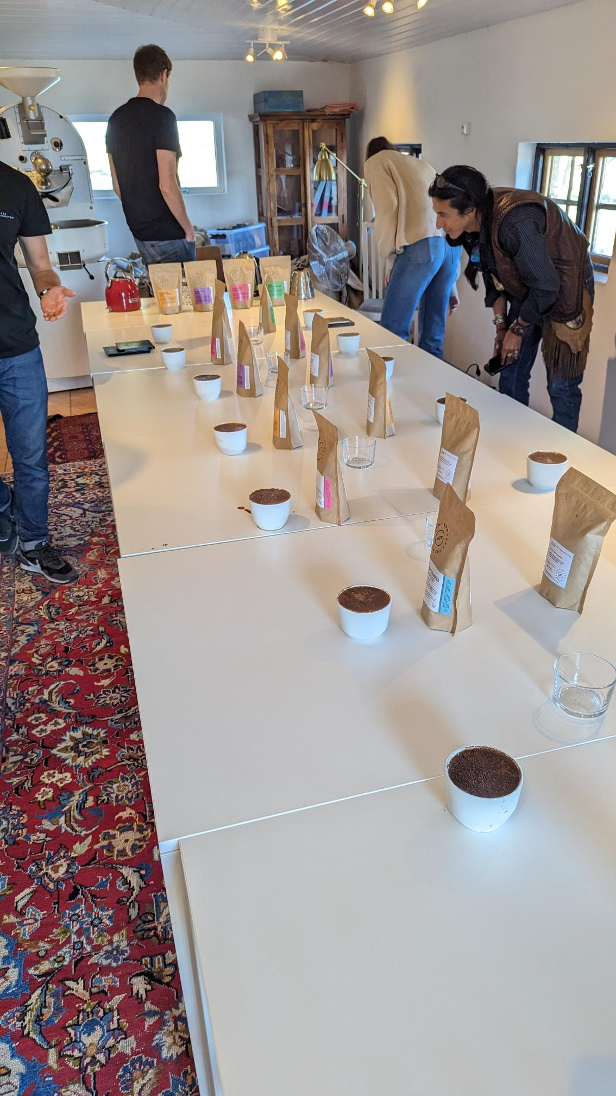

Slide 7
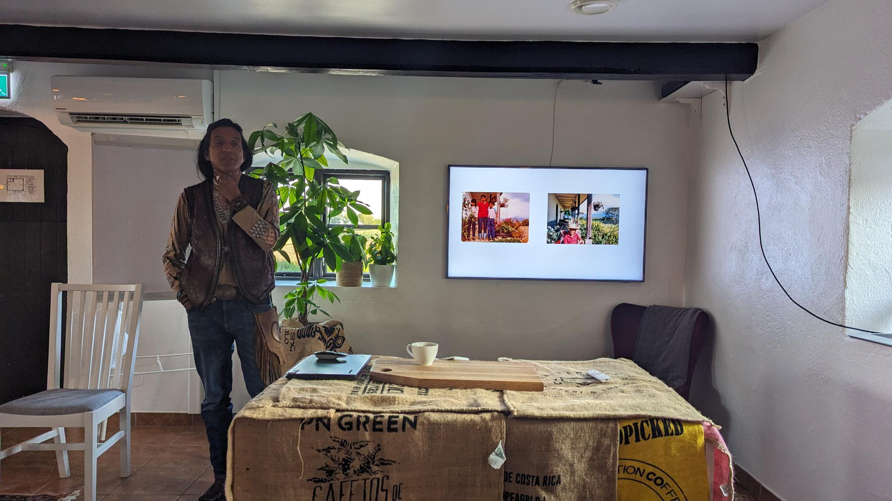

My Coffee Journey
Heber Sarria
Finca La Tierra

Slide 8

My Coffee Journey
POWERSHELL CONFERENCE EUROPE 2023
STARTED
2020
2023
2023
2024
ENJOYED COFFEE FOR THE FIRST TIME
BOUGHT A COFFEE ROASTER
SWEDISH SPECIALTY COFFEE CAMP

Slide 9


Slide 10





Git-based CMS
AppleScript
Static Site Generator
GitHub Pages
PowerShell
Cart & Checkout
Pixelmator Pro

Slide 11
My Coffee Journey
POWERSHELL CONFERENCE EUROPE 2023
STARTED
2020
2023
2026
2023
2024
ENJOYED COFFEE FOR THE FIRST TIME
BOUGHT A COFFEE ROASTER
SPEAKING ABOUT COFFEE AT SWETUGG STOCKHOLM
SWEDISH SPECIALTY COFFEE CAMP

Slide 12



Emanuel Palm
💙 Everything-as-Code
📦 Makes modules & tools
📃 Fan of Open Source
☁️ Blogs at pipe.how
☕️ Roasts coffee at arkanum.coffee
Fun facts!
🧗 Bouldering & Climbing
🎲 Dungeons & Dragons
🥏 Disc Golf
🇸🇪
Cloud Specialist & Coffee Nerd
@PalmEmanuel

Slide 13
Agenda
Introduction to Specialty Coffee
From Farm to Cup
Live Brew + Q & A
Key Takeaways (with a simple brew recipe)
Please ask questions along the way!

Slide 14
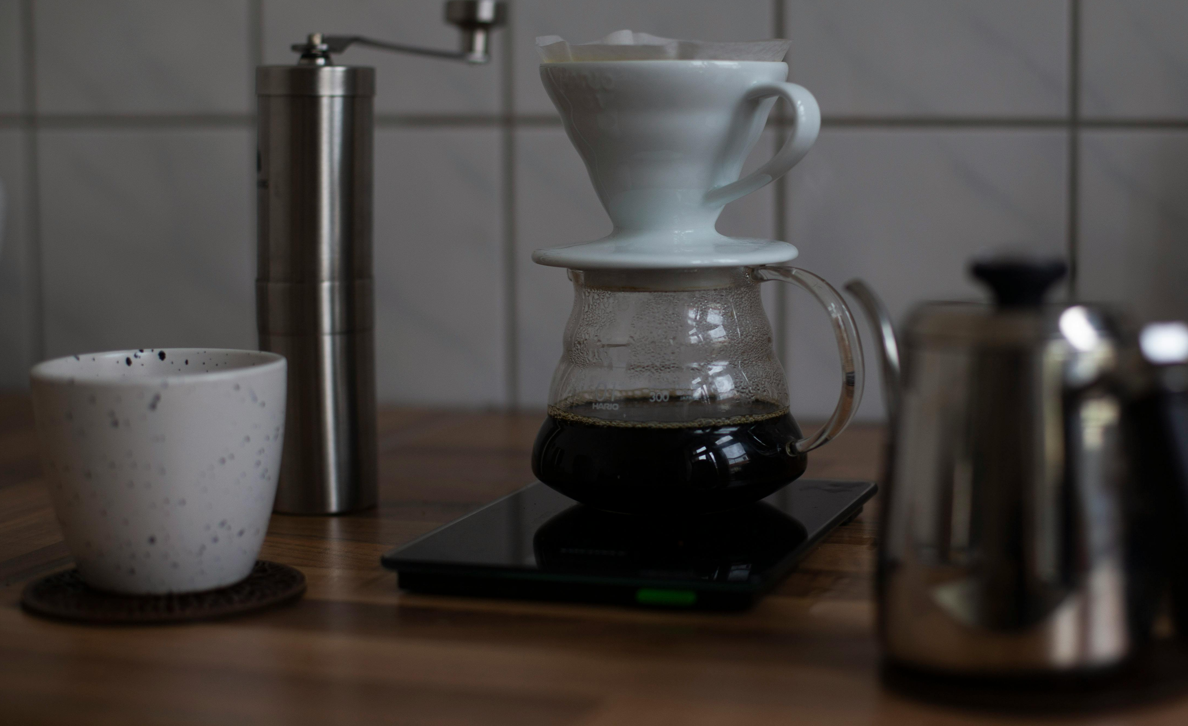
What is Specialty Coffee?
Section
00
Photo by Valeria Palesska: https://www.pexels.com/photo/coffee-pot-on-brown-wooden-table-beside-a-ceramic-cup-9324972/

Slide 15





A coffee or coffee experience that is recognized for its distinctive attributes, resulting in a significantly higher value within the marketplace.
- Specialty Coffee Association (SCA)

Slide 16
What is Specialty Coffee?
Focus on Quality
Traceable
Celebrates the characteristics of each coffee
Previous definition – 80+ on 100 point scale
Aroma, Flavor, Acidity, Body etc 👍
Defects 👎
Certified Q-Graders – “Sommeliers for coffee”

Slide 17
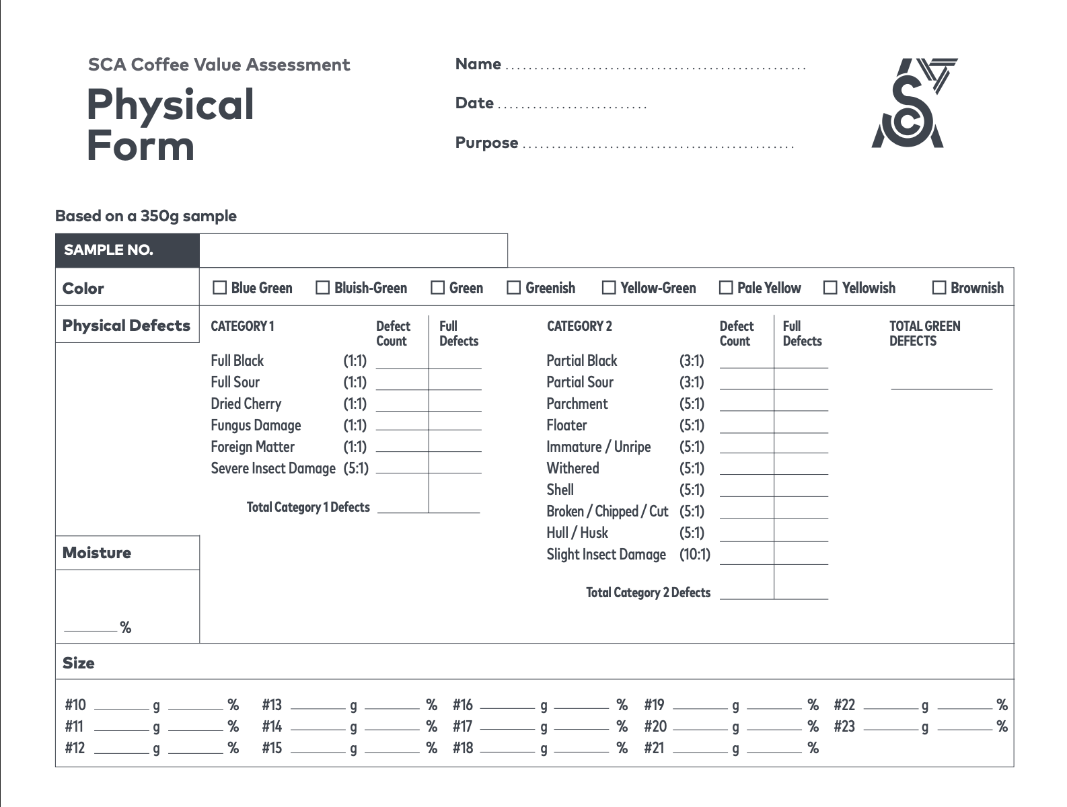

Slide 18
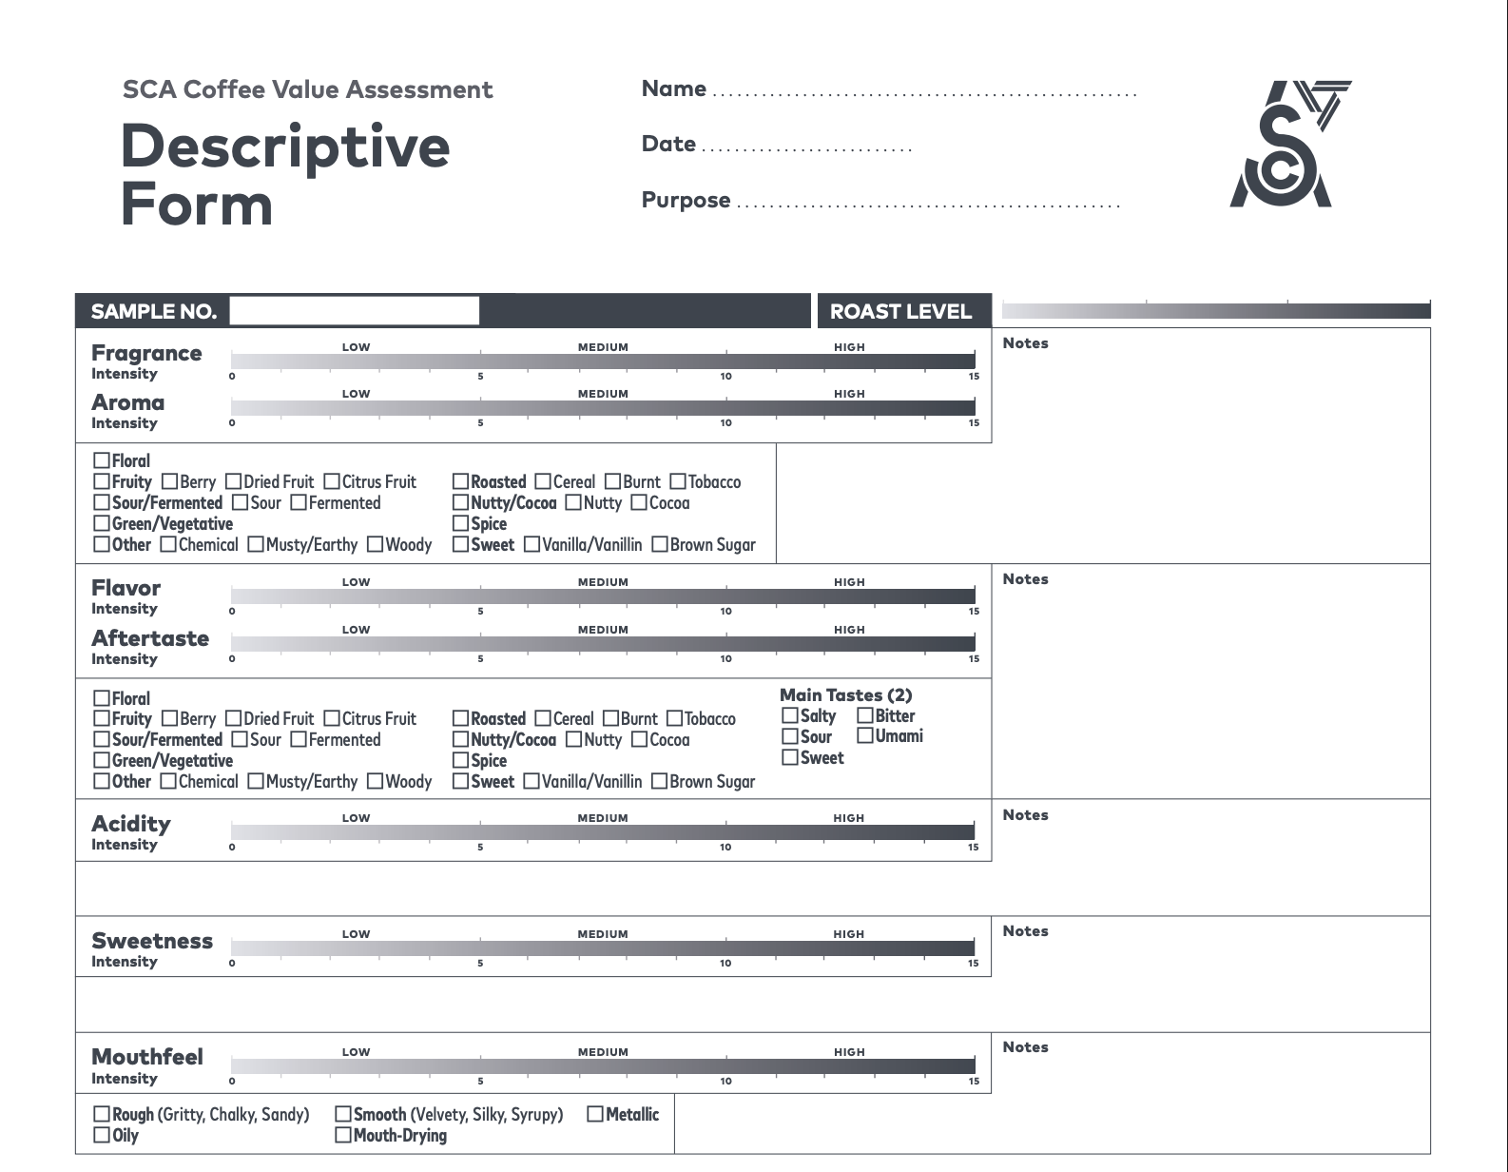

Slide 19
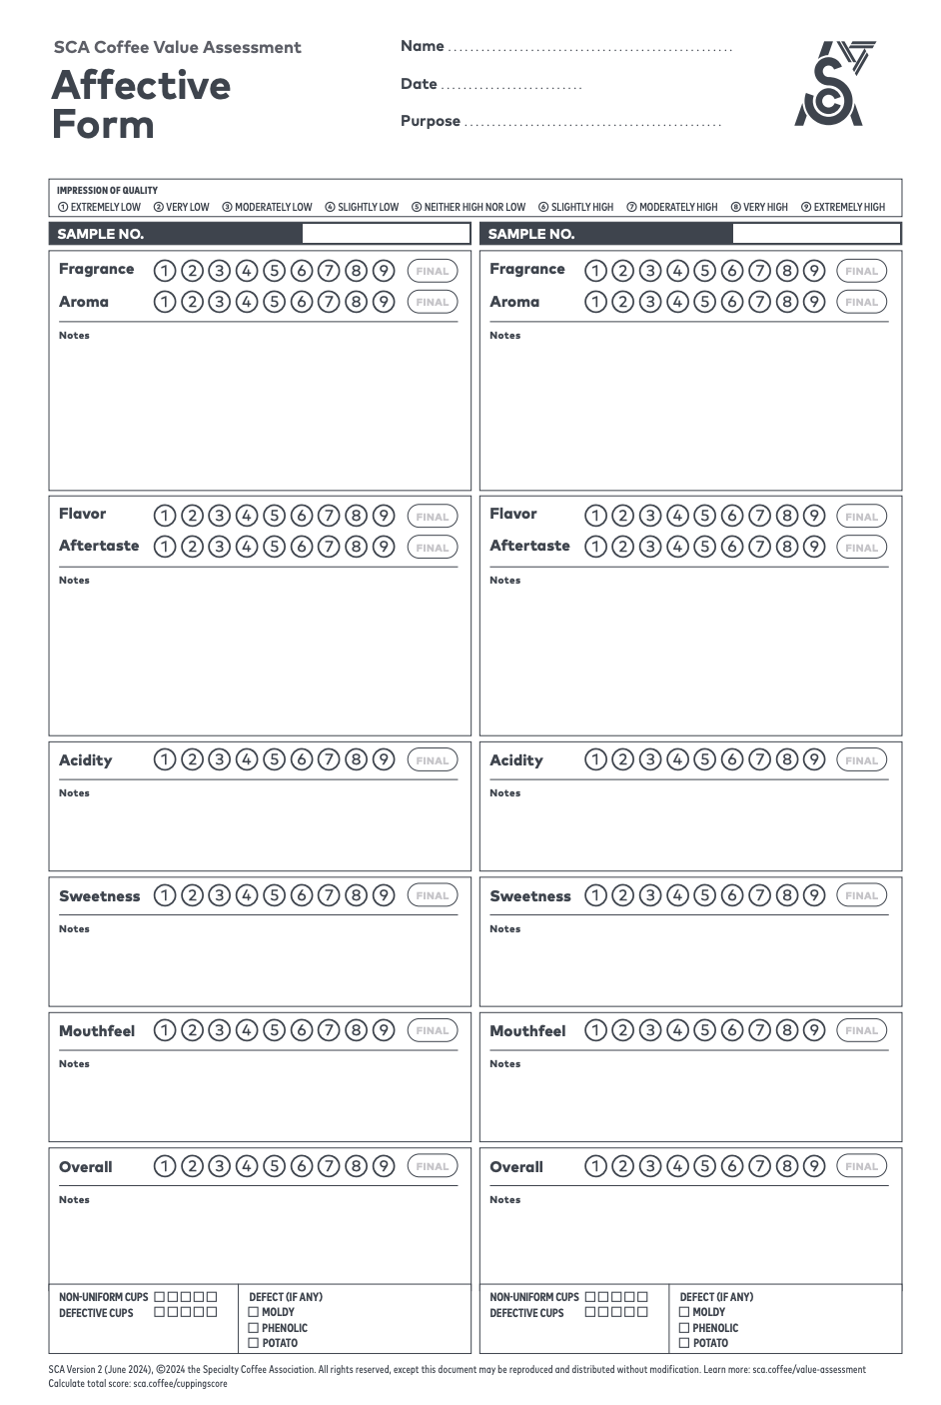

Slide 20
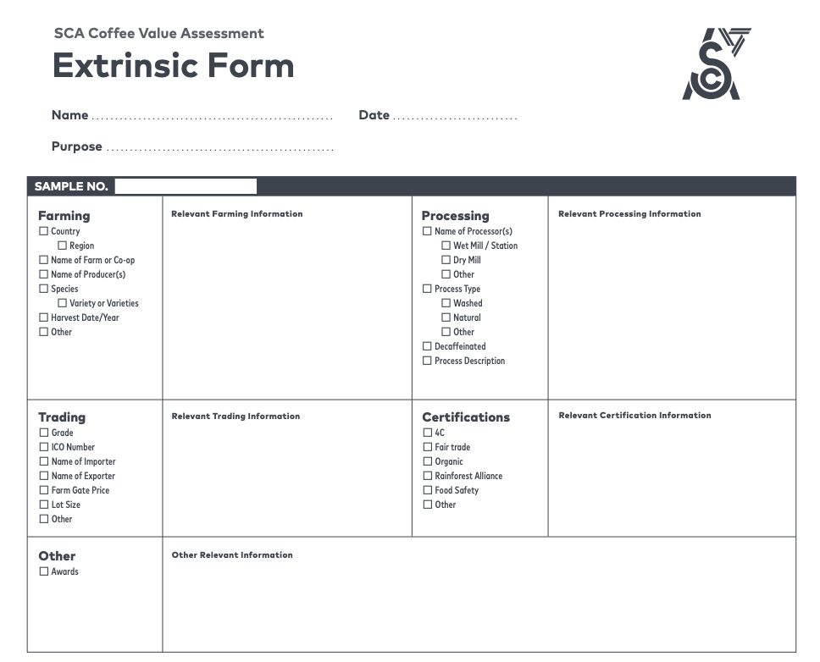

Slide 21
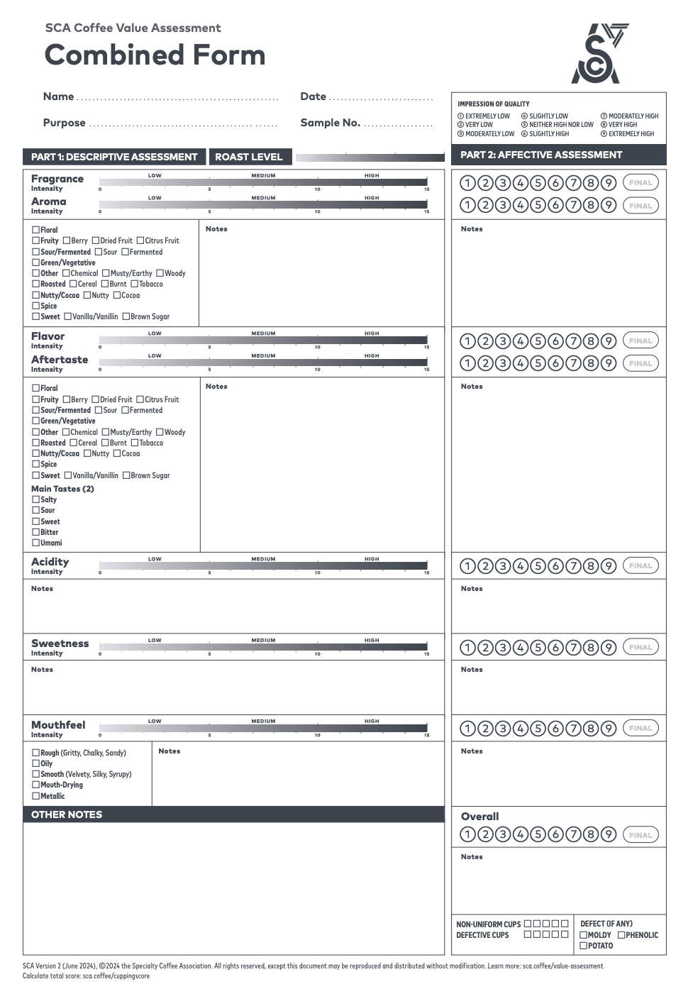

Slide 22
How do I know it’s Specialty Coffee?
More info is a good indicator
Roast date
Origin & Farm info
Altitude
Processing method
Tasting notes
Varietal (not just Arabica)
& more

Slide 23
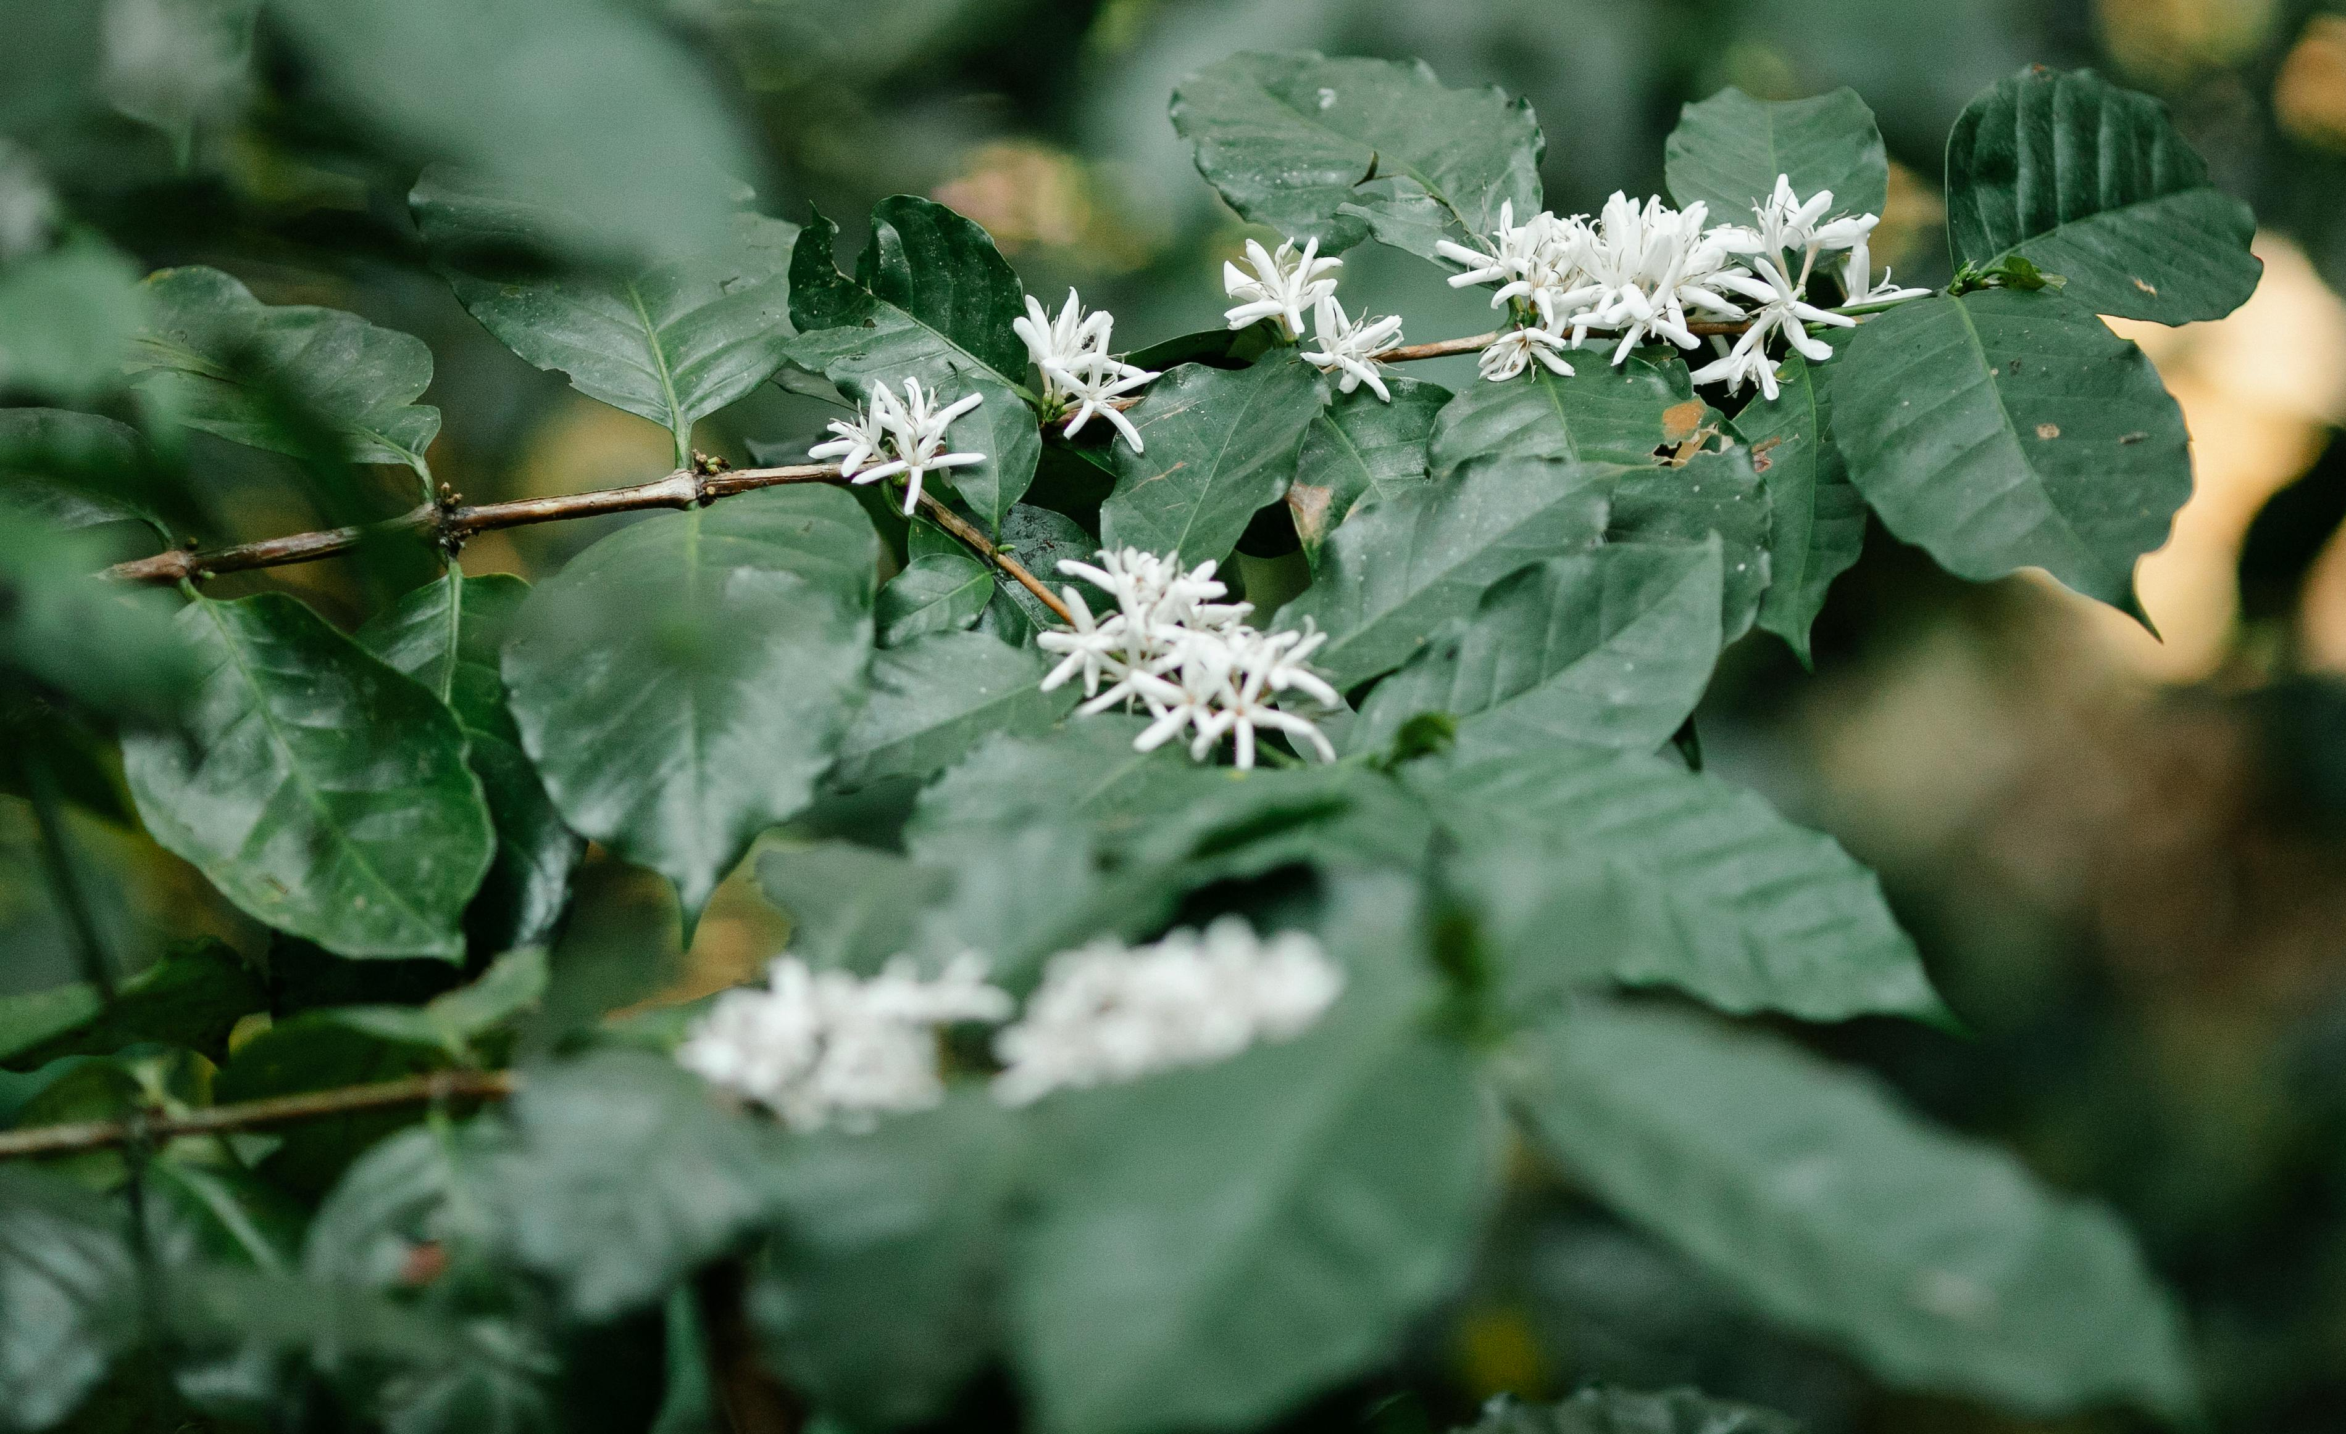
Coffee Farming
Section
01
Photo by Michael Burrows: https://www.pexels.com/photo/blooming-arabian-coffee-shrub-on-plantation-in-countryside-7125398/

Slide 24
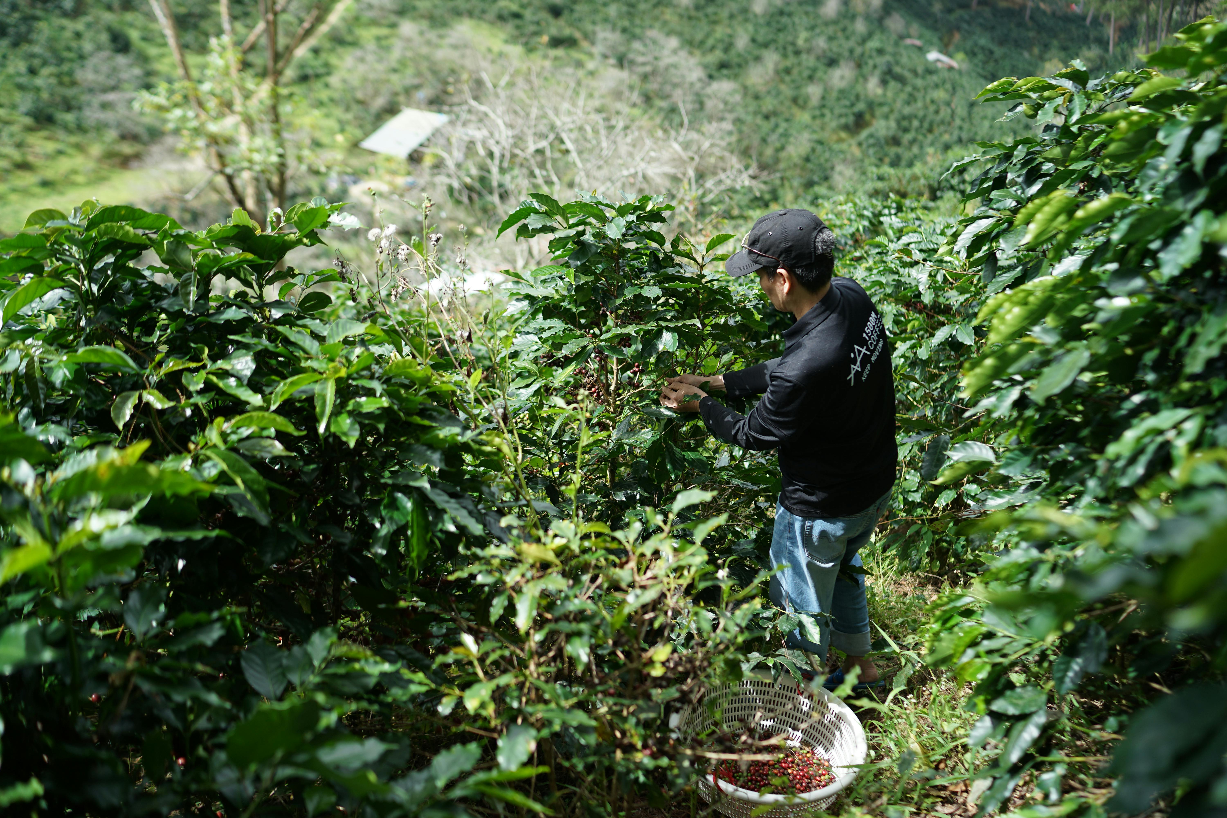
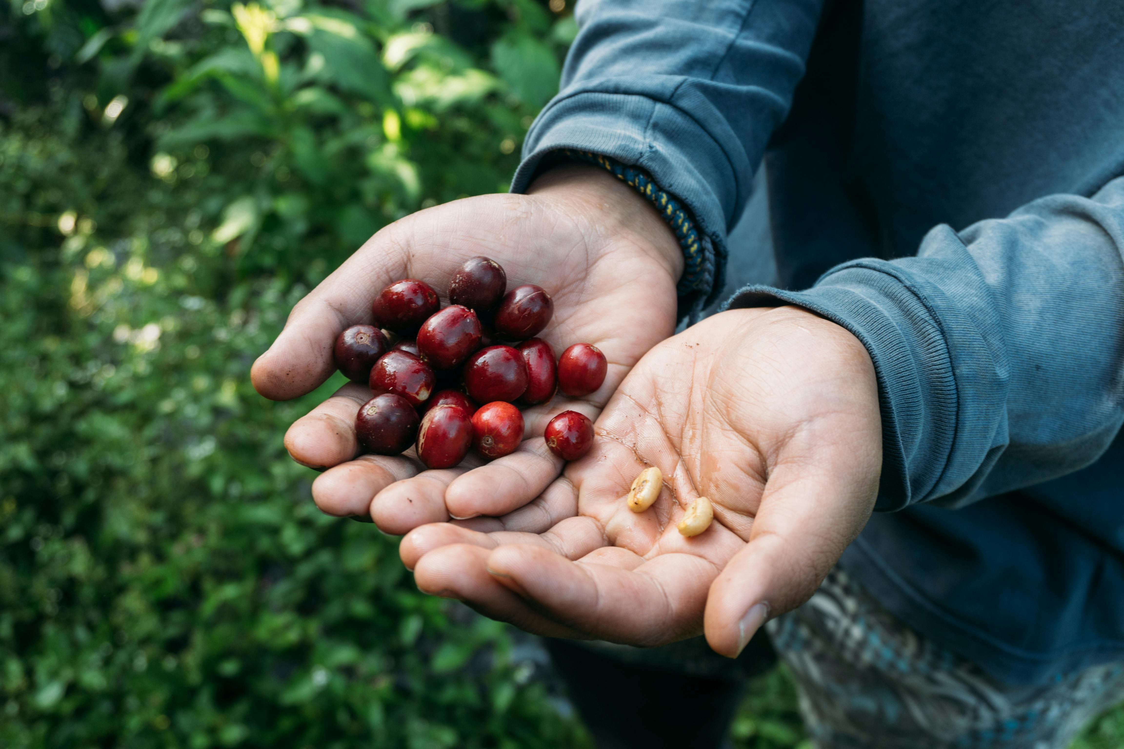
Farming
Coffee is a fruit
Plants grow 2~10 meters
Mostly harvested by hand
Machines pick less precisely
Mountains often aren’t flat
Farm environment matters
High altitude
Photo by Keri Liwi: https://www.pexels.com/photo/close-up-of-hands-holding-fresh-coffee-cherries-and-beans-34411040/
Photo by 1500m Coffee: https://www.pexels.com/photo/coffee-farmer-harvesting-on-hill-plantation-30717831/

Slide 25
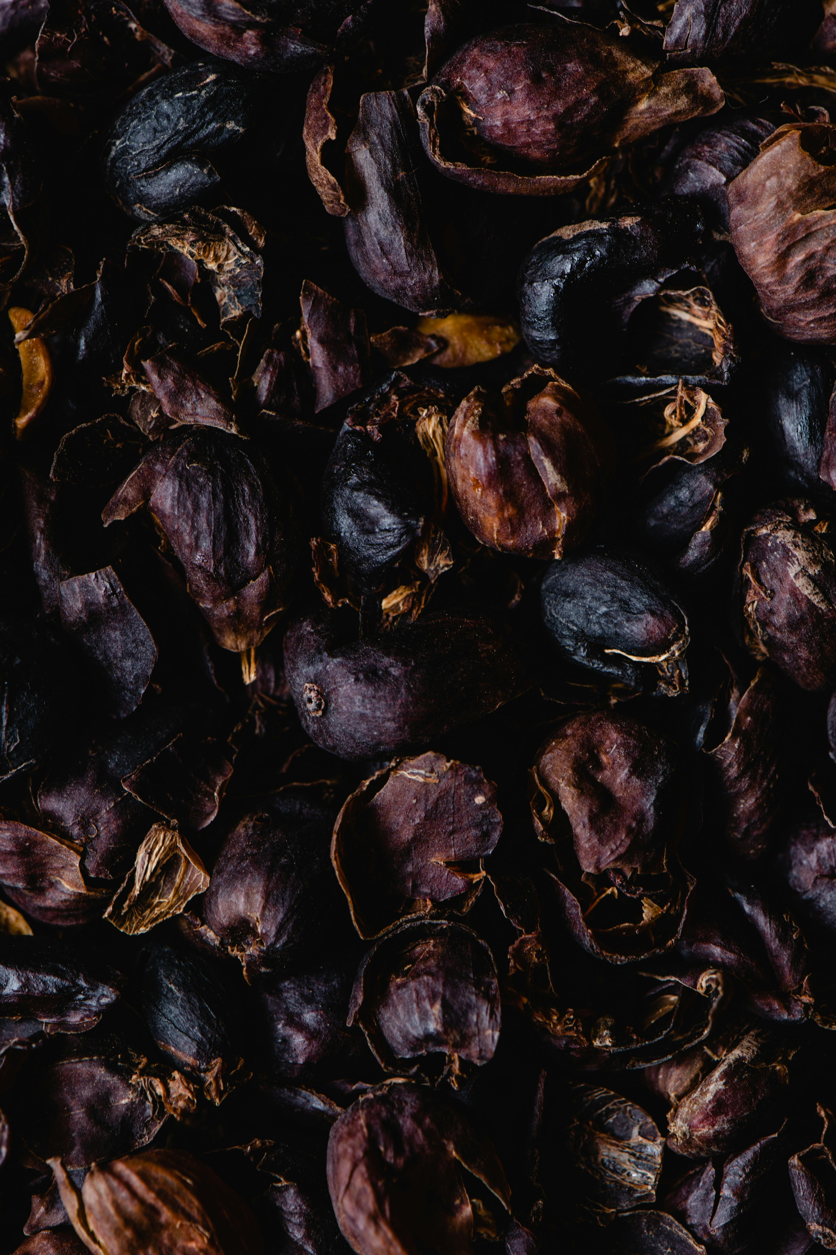
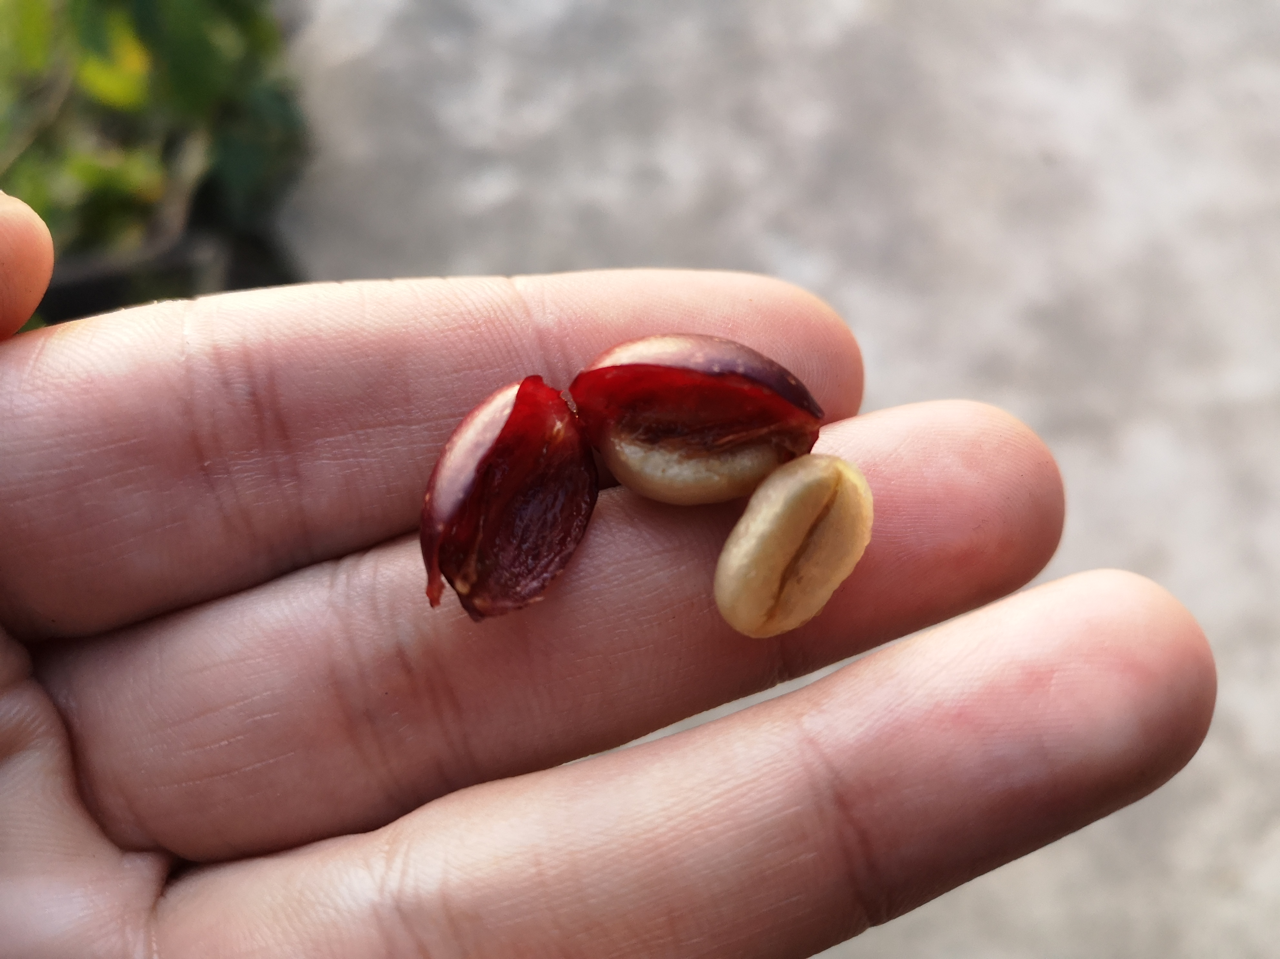

Leftover Pulp, Skin, Husk?
Photo: Huskee Cup, https://www.huskee.co/huskeeoriginal
Photo by Roger Burger
Photo by Eva Bronzini: https://www.pexels.com/photo/close-up-shot-of-dried-coffee-cherry-skin-6087516/

Slide 26

Where is Coffee Grown – “The Coffee Belt”

Slide 27
Where is Coffee Grown?

Slide 28
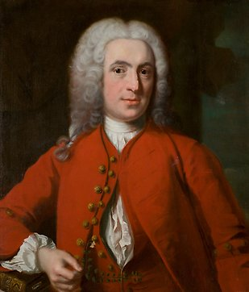
Varietals – “Arabica vs Robusta”
Coffea plant
Initially described by
Carl von Linné
…? Quiz time!
More reading: https://varieties.worldcoffeeresearch.org/

Slide 29
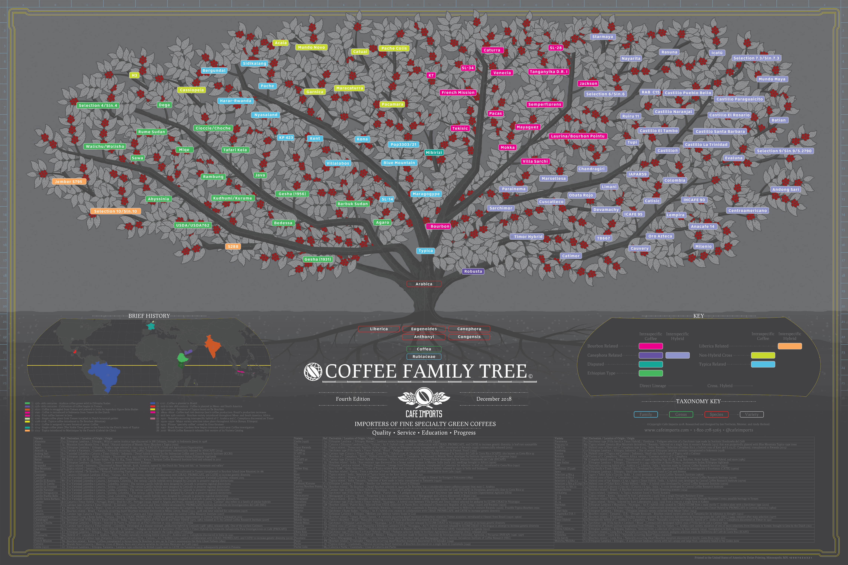
Source: https://www.cafeimports.com/europe/blog/coffee-family-tree/

Slide 32
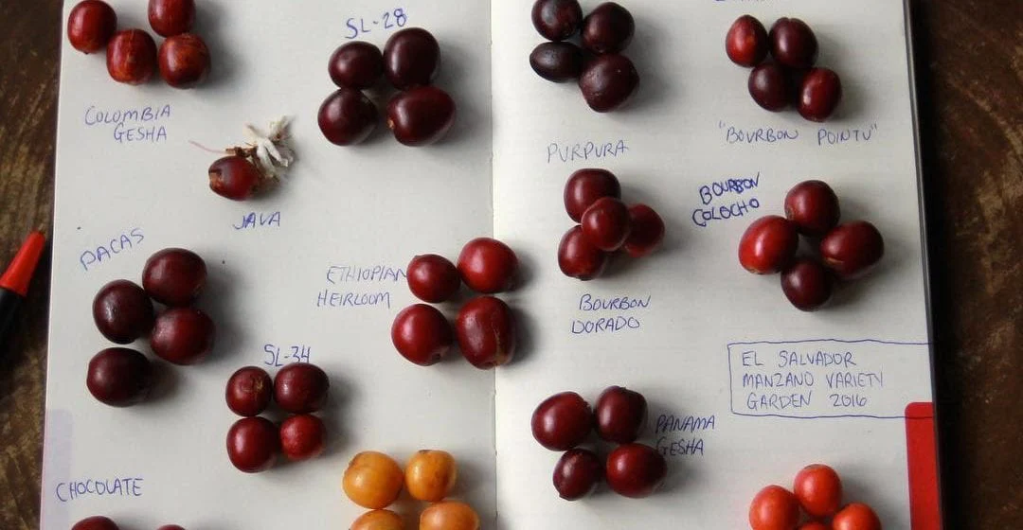
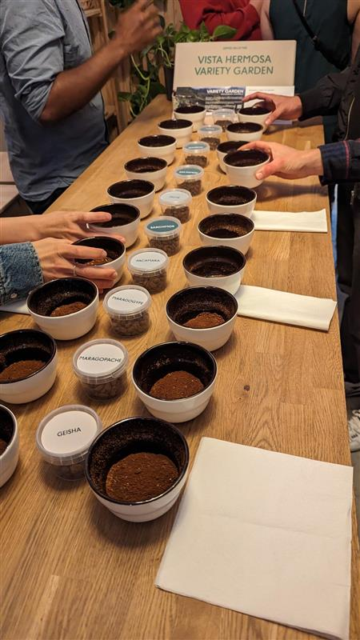
Photo: https://farocoffee.com/blogs/news/all-about-coffee-varieties

Slide 33
Varietals – “Arabica vs Robusta”
Coffea plant
Initially described by
Still finding new coffee species
Development of new coffee species
(No, not in Java)
Why?
Climate change
Yield
Leaf rust resilience
Carl von Linné
More reading: https://varieties.worldcoffeeresearch.org/

Slide 34
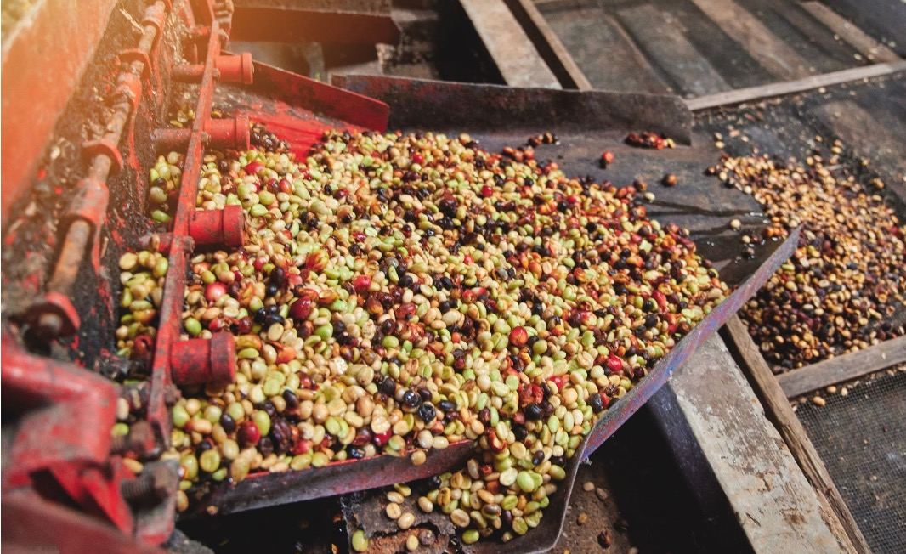
Coffee Processing
Section
02
Photo: https://chidoricoffee.com/blogs/coffee-blog/process-method-how-coffee-gets-processed

Slide 35
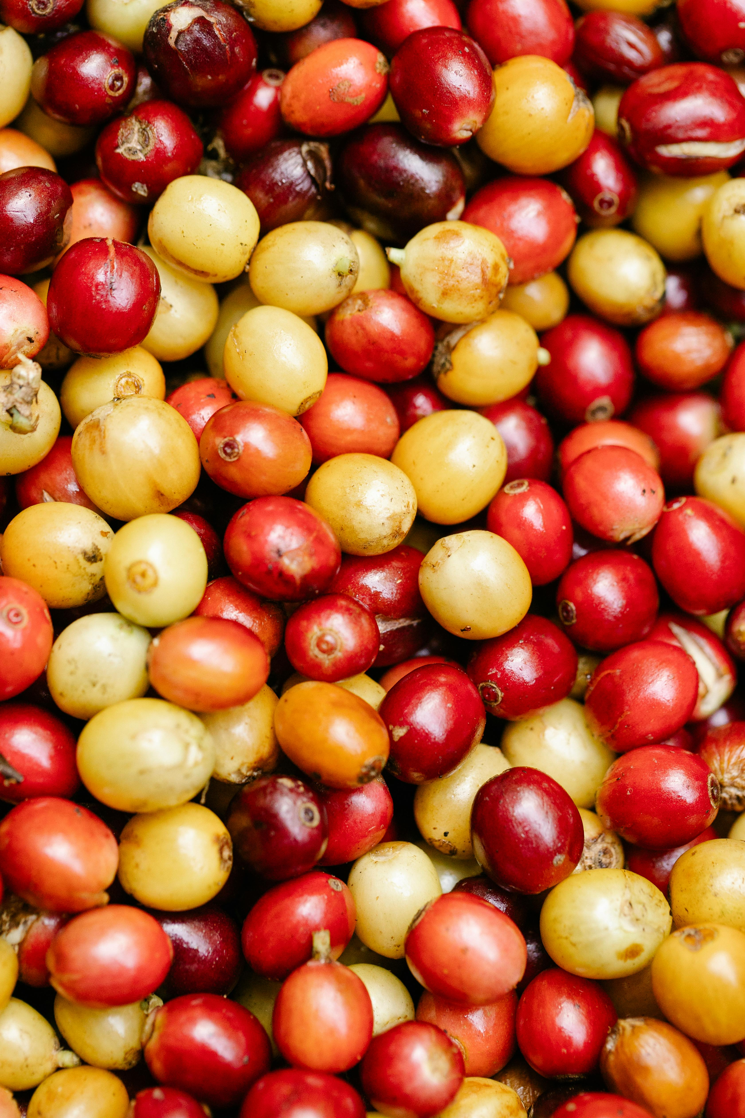
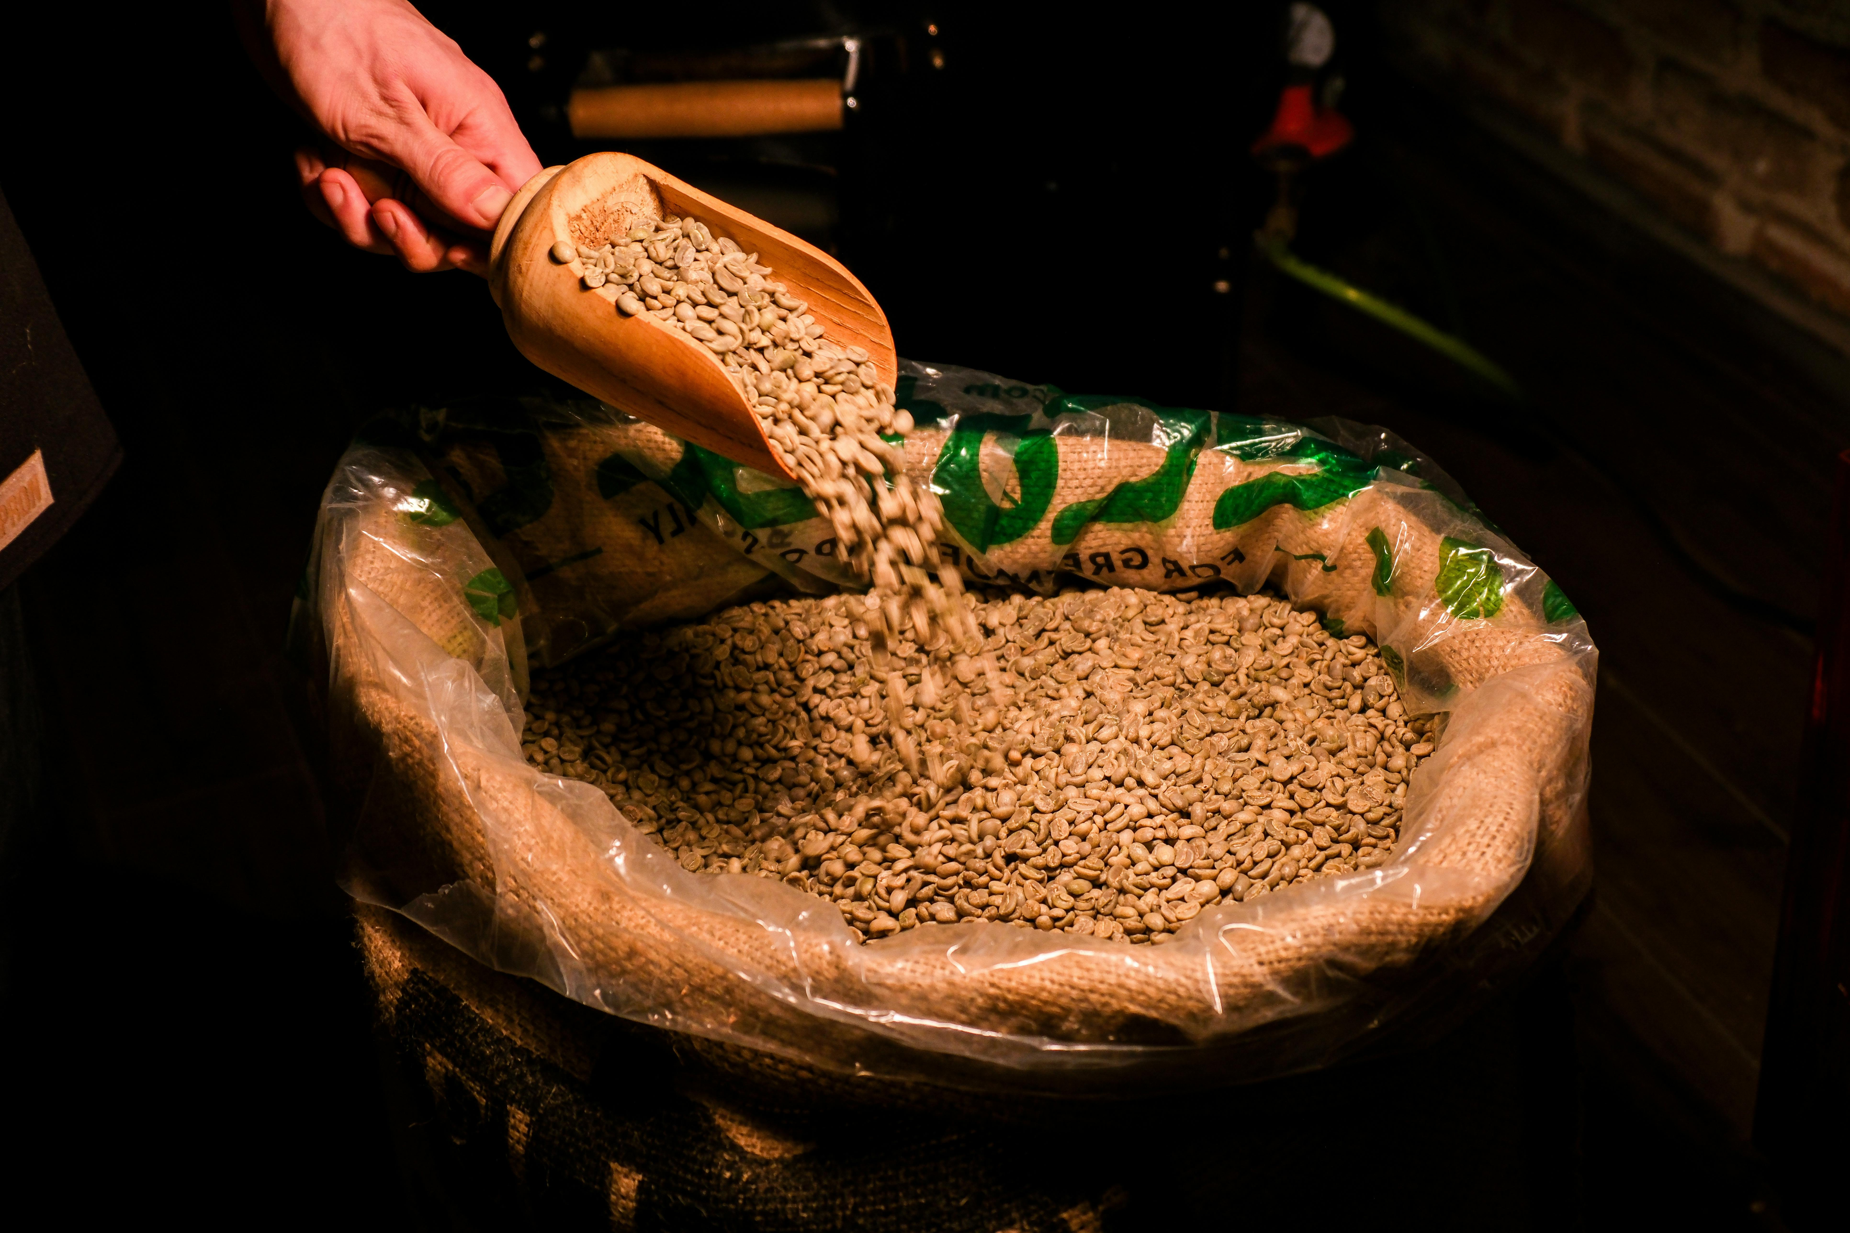


Coffee Processing
“Green Coffee”
Photo by Ferhat E. Arslan: https://www.pexels.com/photo/scooping-raw-coffee-beans-into-burlap-sack-29873454/
Photo by Michael Burrows: https://www.pexels.com/photo/backdrop-of-assorted-coffee-fruits-with-pleasant-aroma-7125589/

Slide 36
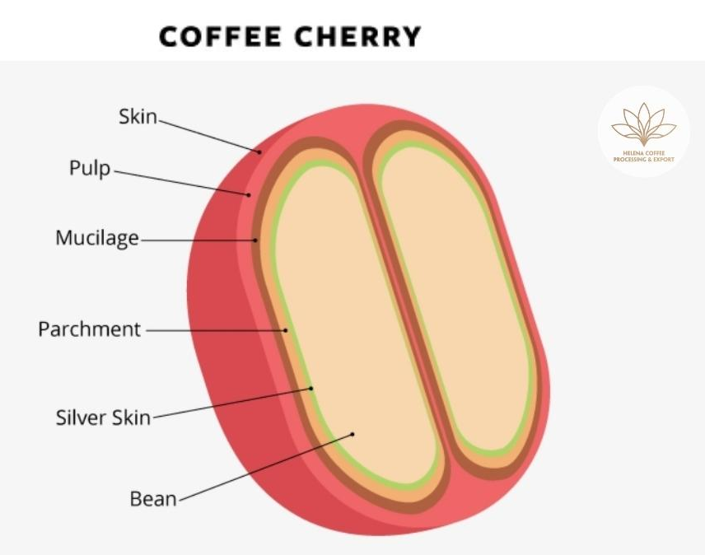
Coffee Processing
Small farms rarely have equipment – Central Dry or Wet “Mill”
“Get beans out” and lower moisture to 11~12%
Three main processing methods
Washed
Natural
Honey
Photo: https://www.helenacoffee.vn/coffee-processing-what-is-dry-processed-coffee-basics-detailed-procedure-characteristics-flavor-market-demand/

Slide 37
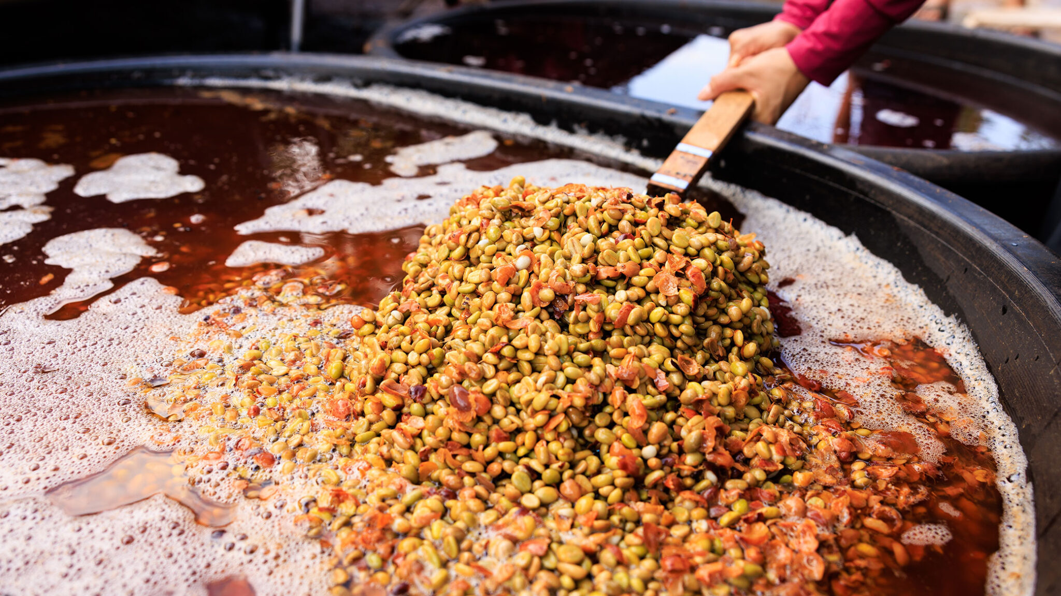
Washed (Wet) Process
1. Sort – By floating, by hand, by sieve
1. Sort – By floating, by hand, by sieve
2. Depulper machine
3. Fermentation – hours to days
4. Washed to clean the beans
5. Dry on sun beds and/or mechanically
6. Hulling machine
Uses a lot of water
Variations like Double Washed
Often “clean” flavor profiles
Varietal
Origin
Terroir / Environment
Flavor clarity, bright, higher acidity, less body*
2. Dry on sun beds
3. Hulling machine
Photo: https://www.aboutcoffee.org/beans/processes/

Slide 38
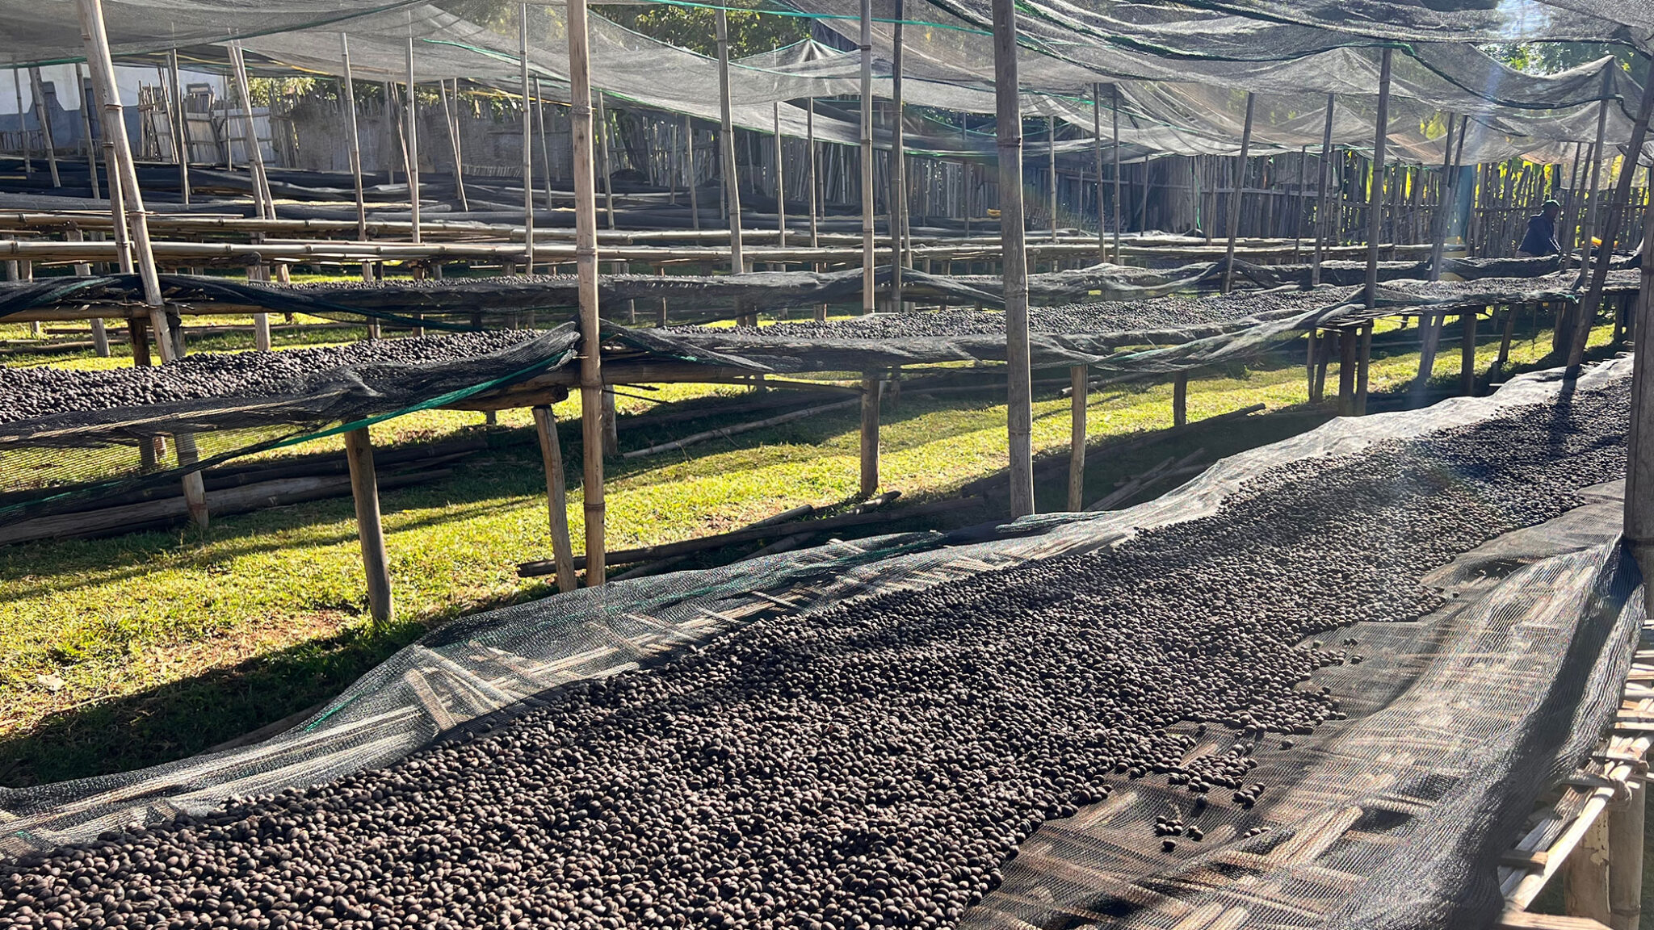
Natural (Dry) Process
1. Sort – By floating, by hand, by sieve
More labor-intensive
More intense flavor profiles
Fruity, sweet, “funky”, heavy body*
2. Dry on sun beds
3. Hulling machine
Photo: https://www.aboutcoffee.org/beans/processes/

Slide 39
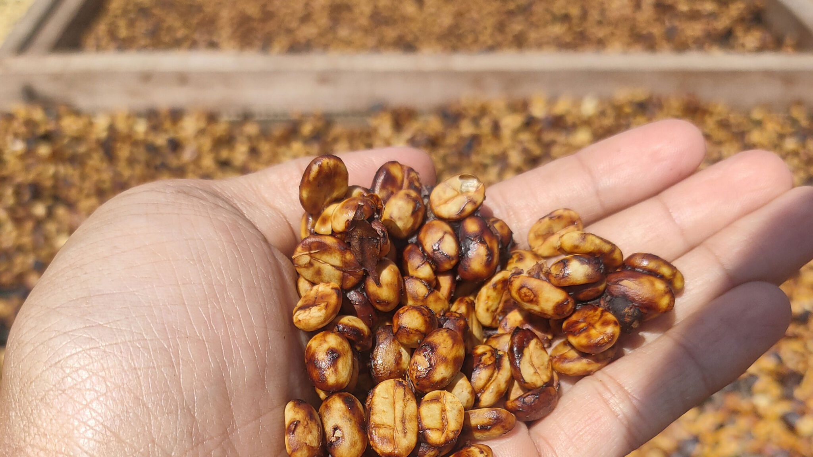
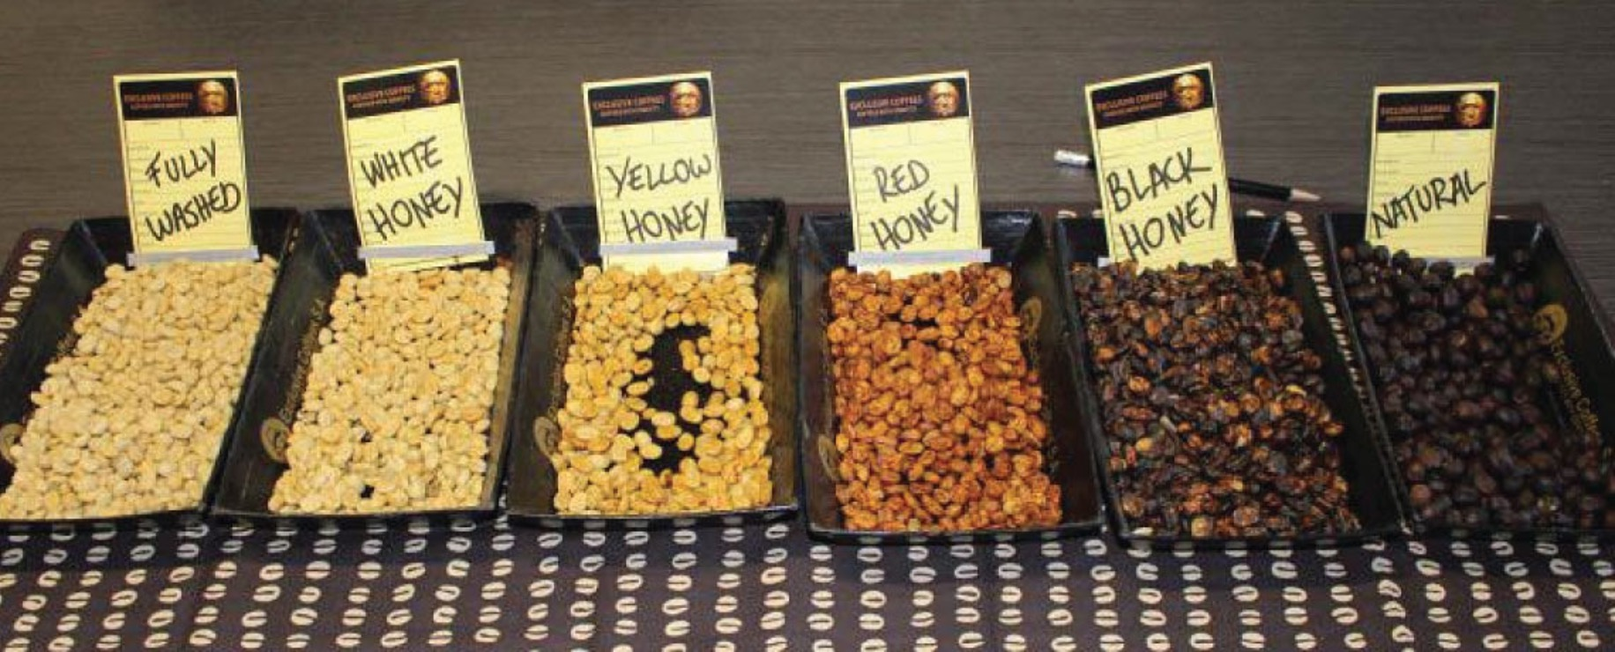
Honey (Pulped Natural) Process
1. Sort – By floating, by hand, by sieve
1.5 Depulper machine
Does not involve honey
Multiple variants
White
Yellow
Gold
Red
Black
2. Dry on sun beds
3. Hulling machine
Washed
Natural
Photo: https://elamigocoffee.com/coffee-processes/
Photo: https://www.aboutcoffee.org/beans/processes/

Slide 40
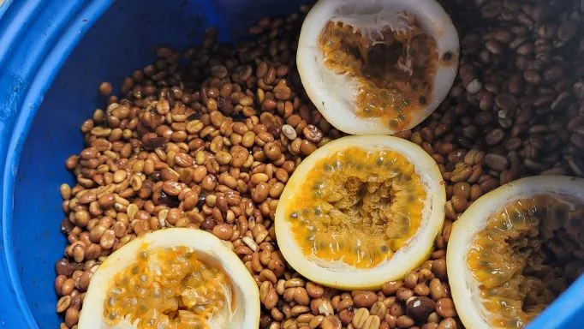
Modern / Experimental Processes
Processing can raise price above initial quality
Co-fermentation – Fruit, herbs…
Anaerobic fermentation
Carbonic Maceration
Yeast Inoculation
Thermal Shock
Osmotic Dehydration
Others…
Photo: https://www.covoyacoffee.com/blog/fruit-fermentation-coffee-processing.html

Slide 41
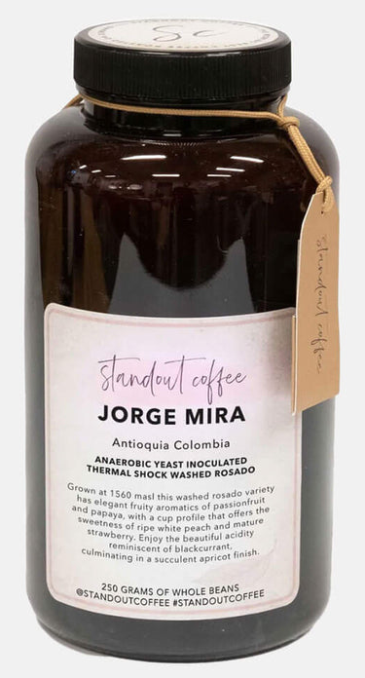
Flavors
All flavors are natural – At least in Specialty Coffee
A lot of similarities to wine
Over 1000 volatile compounds in both coffee and wine
Breakfast Coffees vs Sipping Coffees
Drinking temperature, flavor perception
Good coffee still tastes good when cooled

Slide 42
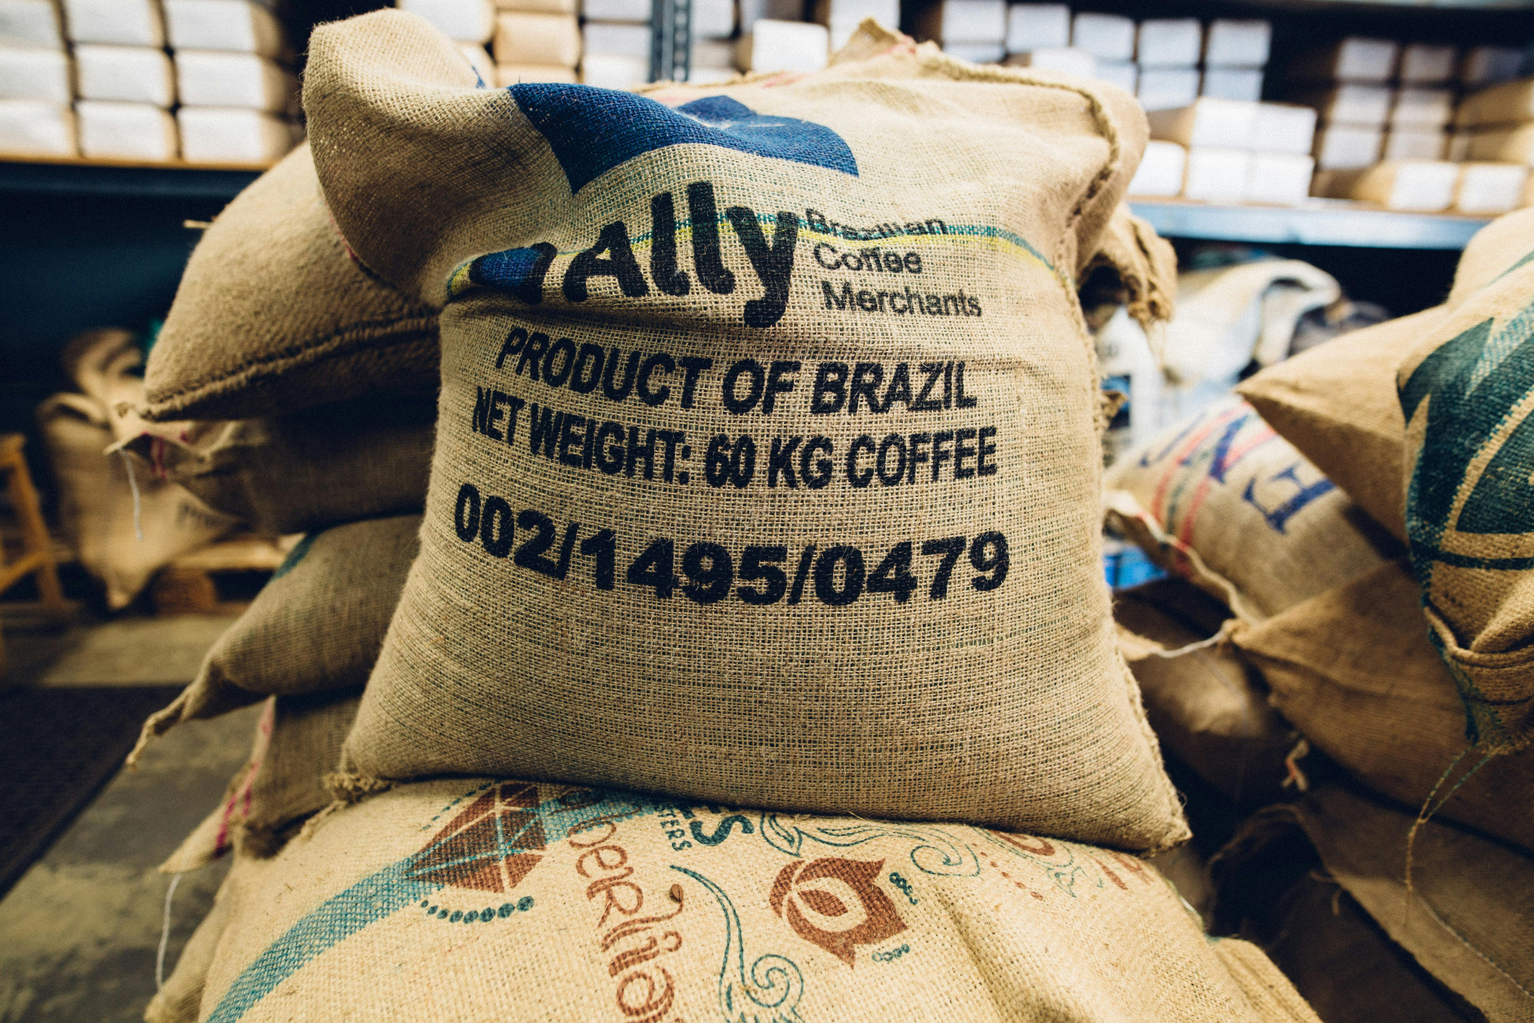
Supply Chain & Market
Section
03
Photo by Kelly: https://www.pexels.com/photo/sacks-of-coffee-beans-2868982/

Slide 43








Supply Chain & Market
🌱
👥
📦
🌍
🔥
☕
👩‍💻
Farm
Cooperative
Exporter
Importer
Roaster
Café
Consumer

Slide 44
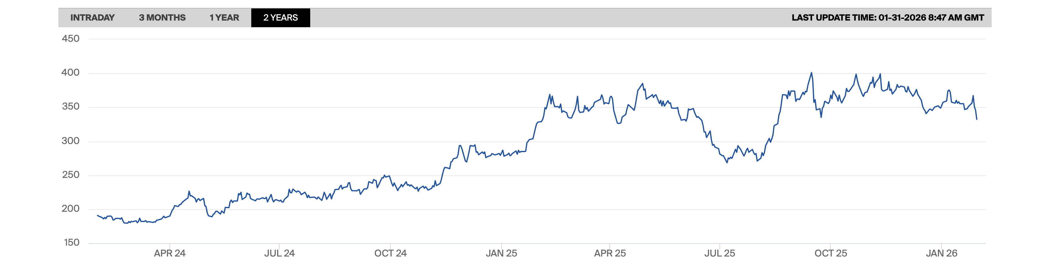

Supply Chain & Market
Commodity / Commercial coffee - “C Price”
Global benchmark for Arabica, but not Specialty Coffee
Supply chain, climate, politics

Slide 45
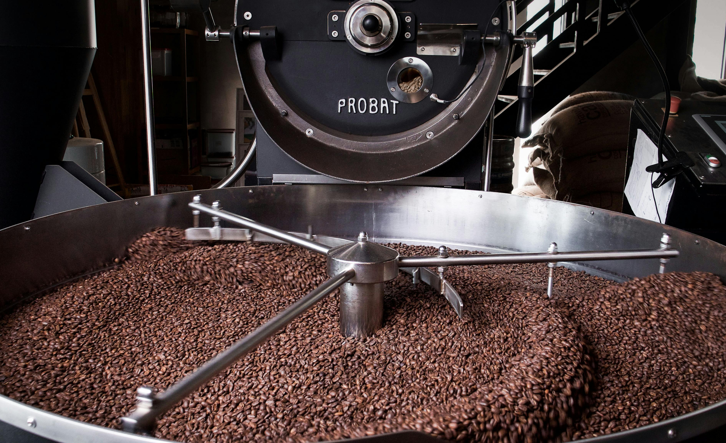
Roasting
Section
04
Photo by Hannoversche Kaffeemanufaktur: https://www.pexels.com/photo/coffee-roasting-12088958/

Slide 46
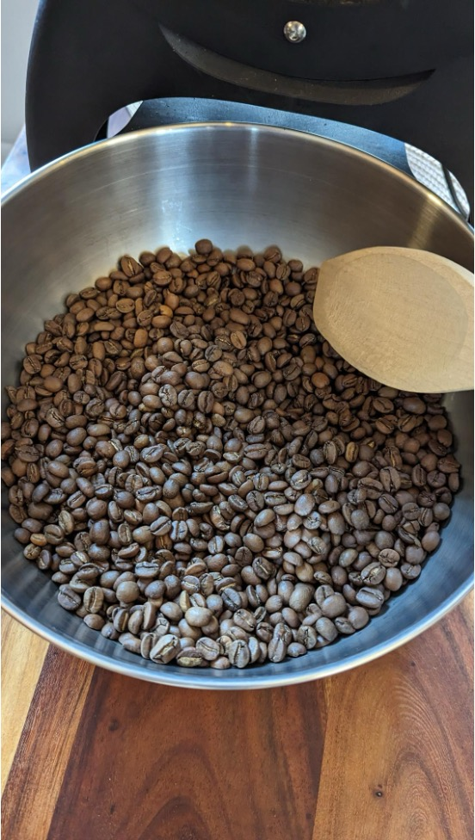

Roasting
🔥
Photo: Me
Photo by Ferhat E. Arslan: https://www.pexels.com/photo/scooping-raw-coffee-beans-into-burlap-sack-29873454/

Slide 47
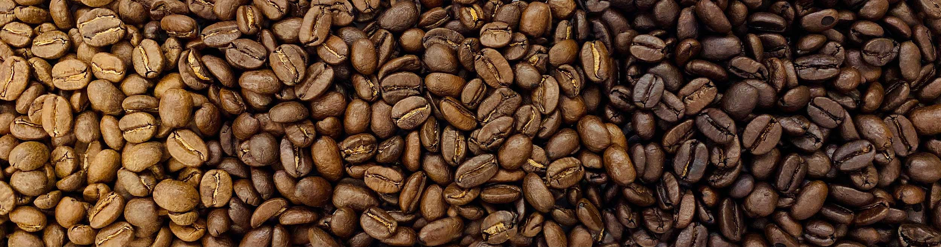
Roasting
Photo by Hannoversche Kaffeemanufaktur: https://www.pexels.com/photo/coffee-roasting-12088958/
Light*, Medium and Dark is simplest descriptors
*Nordic light roast is much lighter
Color determines 80% of the flavor for a particular coffee
Roasting dark can ruin good coffee – But “hide” bad coffee
Characteristics are lost throughout the roast

Slide 48
When to drink, for how long?
Resting coffee after roasting – Degassing CO₂
Time depends on roast level
Light roast – 2~3 weeks off roast
Medium roast – 1~2 weeks
Dark roast – Less than a week
Safe to drink forever*
Can be frozen forever*
Photo by Cup of Couple: https://www.pexels.com/photo/person-holding-hourglass-7657893/

Slide 49
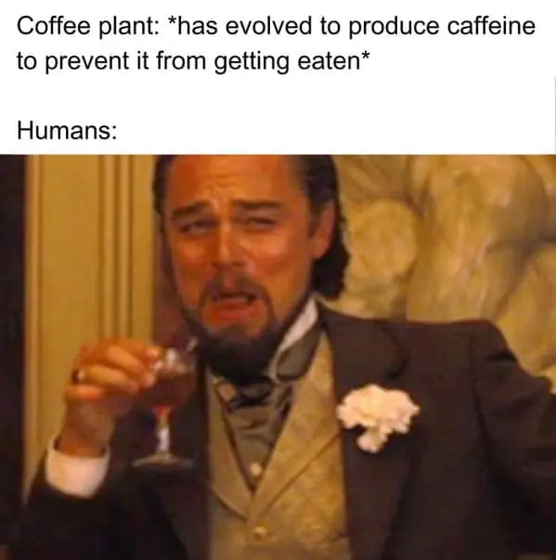
Caffeine
Caffeine only small part of bitterness
Light vs dark roast?
Robusta has more than Arabica
Extreme variation between cafés
What about decaf?
Multiple good methods exist

Slide 50
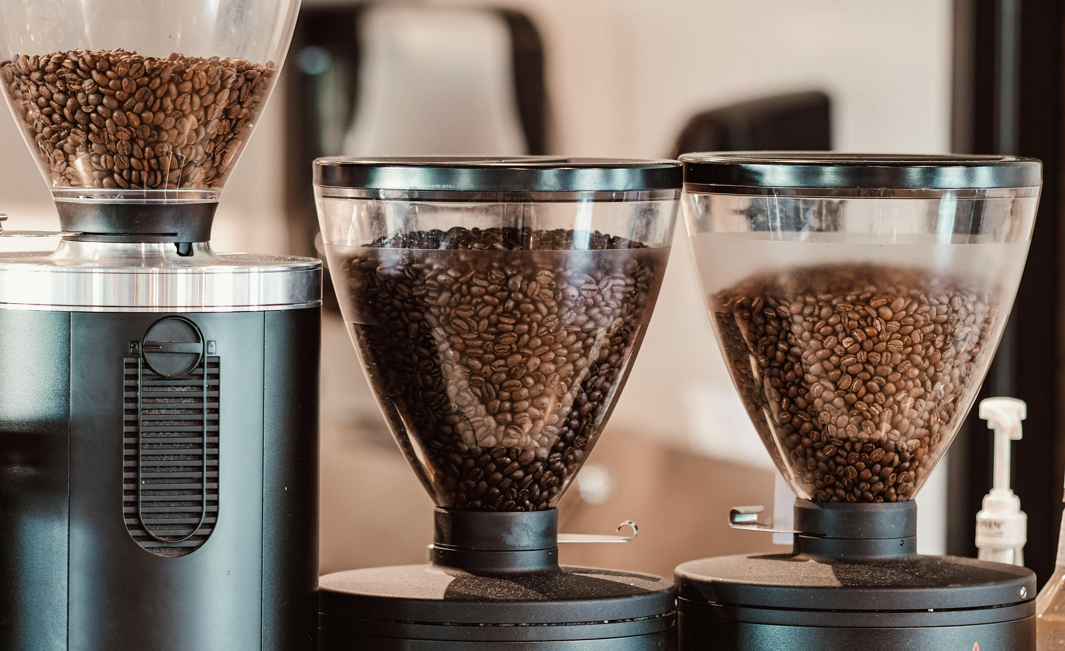
Grinding
Section
05
Photo by Eric Steinhauer: https://www.pexels.com/photo/roasted-coffee-beans-in-a-coffee-grinder-machine-13272708/

Slide 51
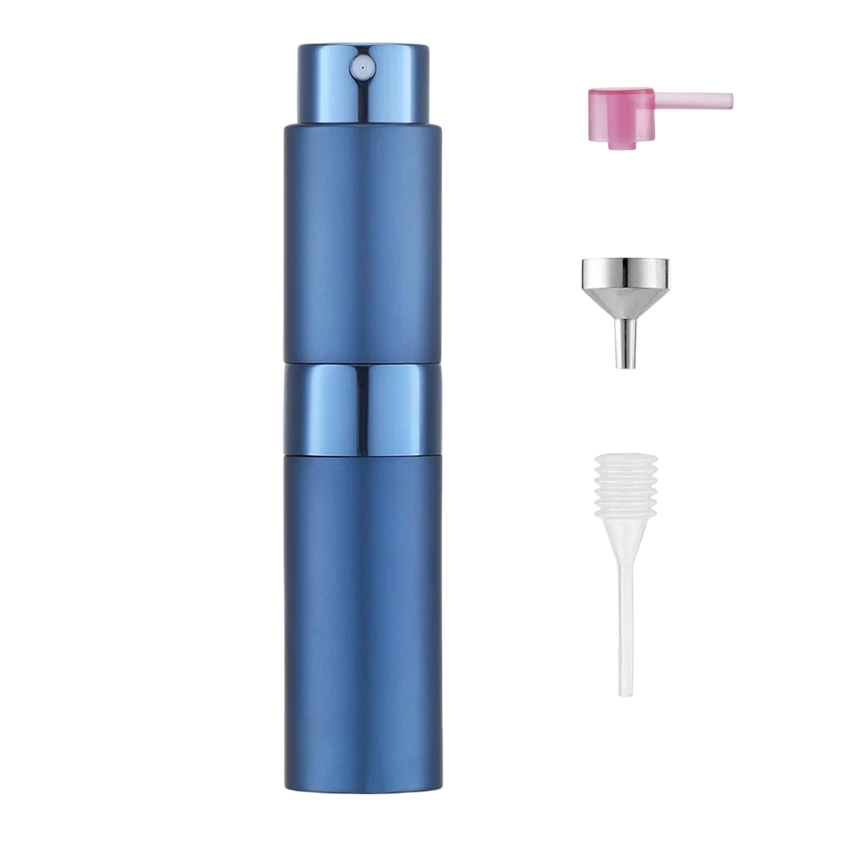

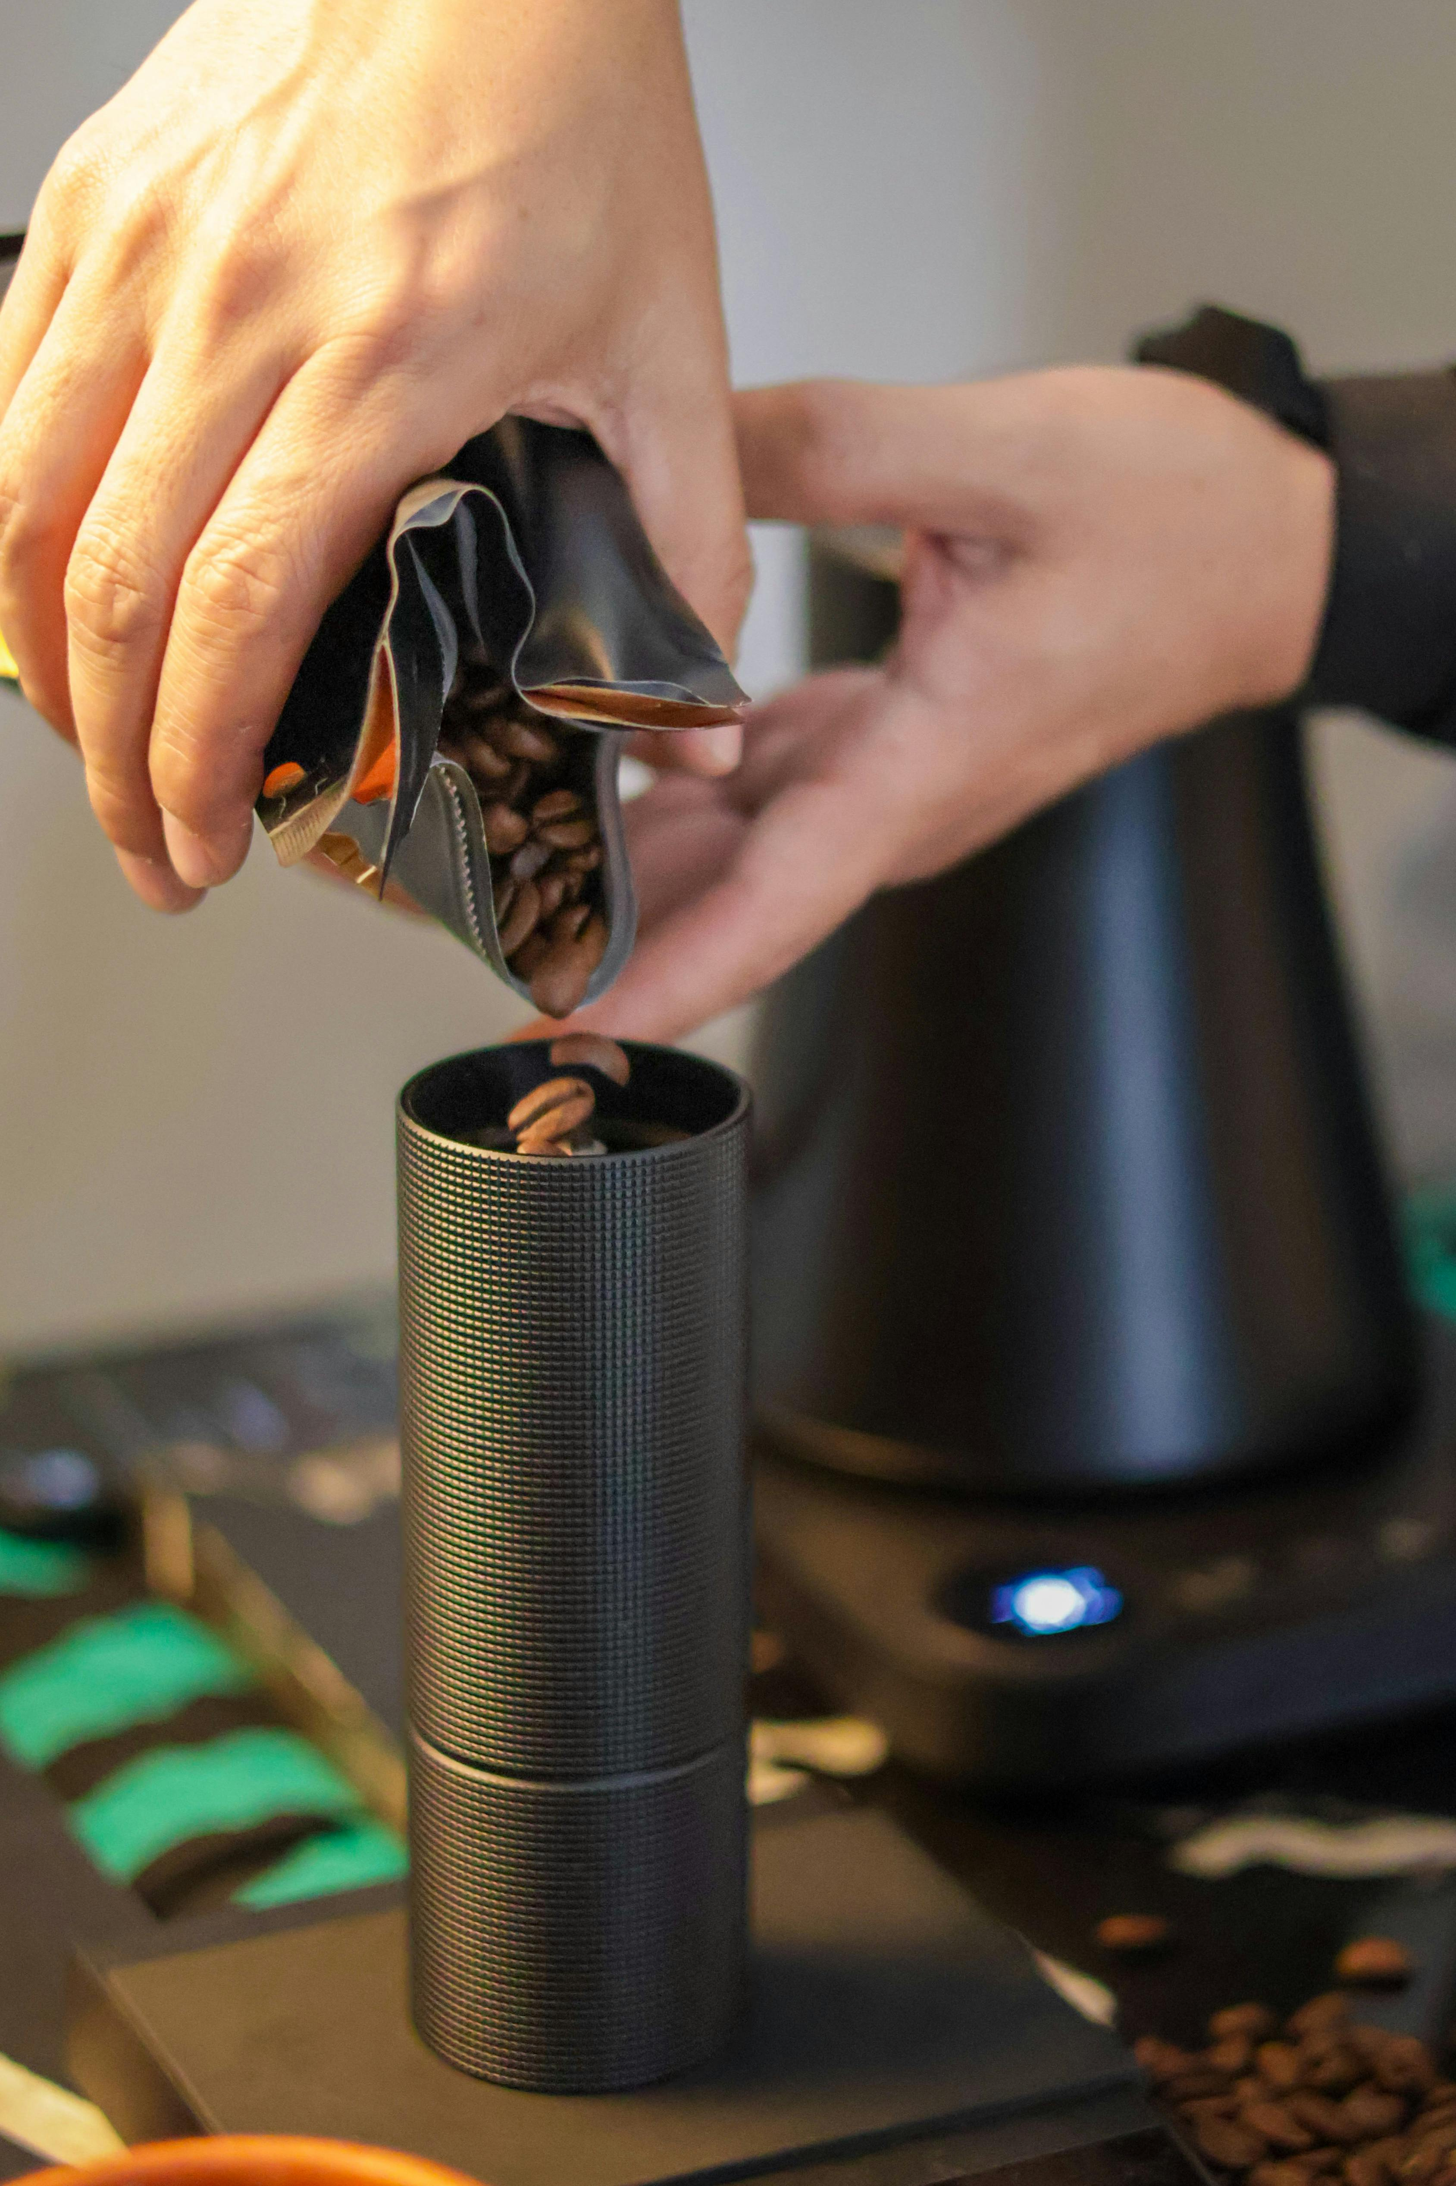
Grinding
Finer grind
More surface area
More contact with water
Easier to extract flavor
Coarser grind = Opposite
Grinder is the #2 best investment
Grind as fresh as possible – Oxidation
Reduce static – Ross Droplet Technique (RDT)
Photo by Carlos Misael Cruz López : https://www.pexels.com/photo/close-up-of-coffee-beans-being-poured-into-grinder-34437400/

Slide 52
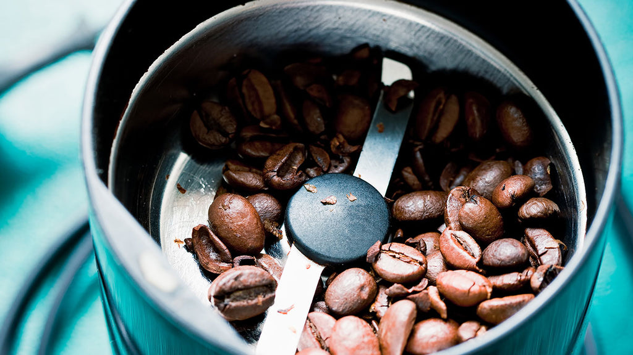
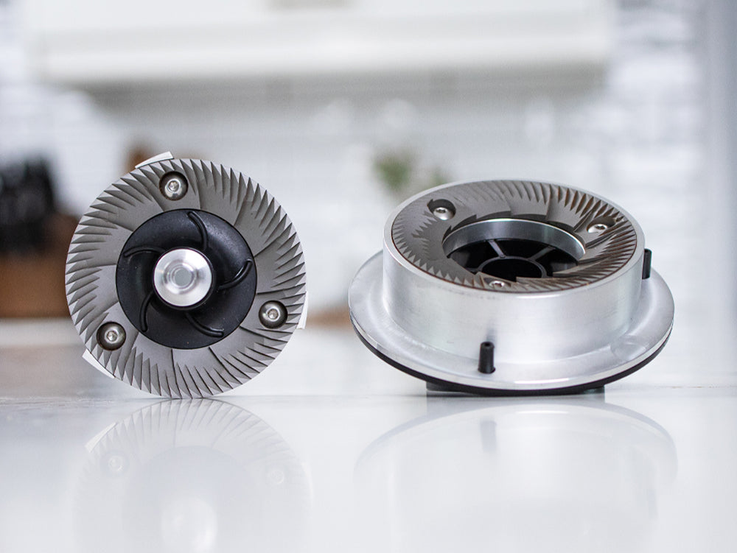
Grinders
Consistency is important
Burrs > Blades
Hand Grinder vs Electric Grinder?
Things to care about:
Adjustability
Capacity
Size Range
(Price)
Photo: https://wholelattelove.ca/blogs/quick-tips/a-beginners-guide-to-coffee-grinders
Photo: https://www.nichecoffee.co.uk/blogs/exploring-coffee/conical-vs-flat-burr-grinders-which-are-the-best

Slide 53
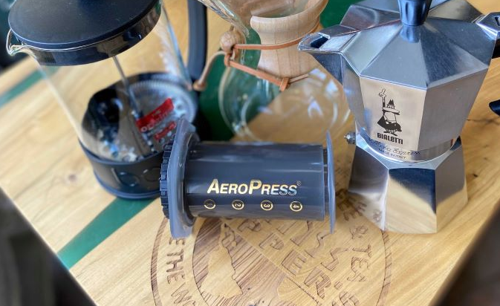
Brewing
Section
06
Photo: https://www.cuppers.ca/blog/13-types-of-coffee-brewer-explained-what-is-right-for-you/

Slide 54
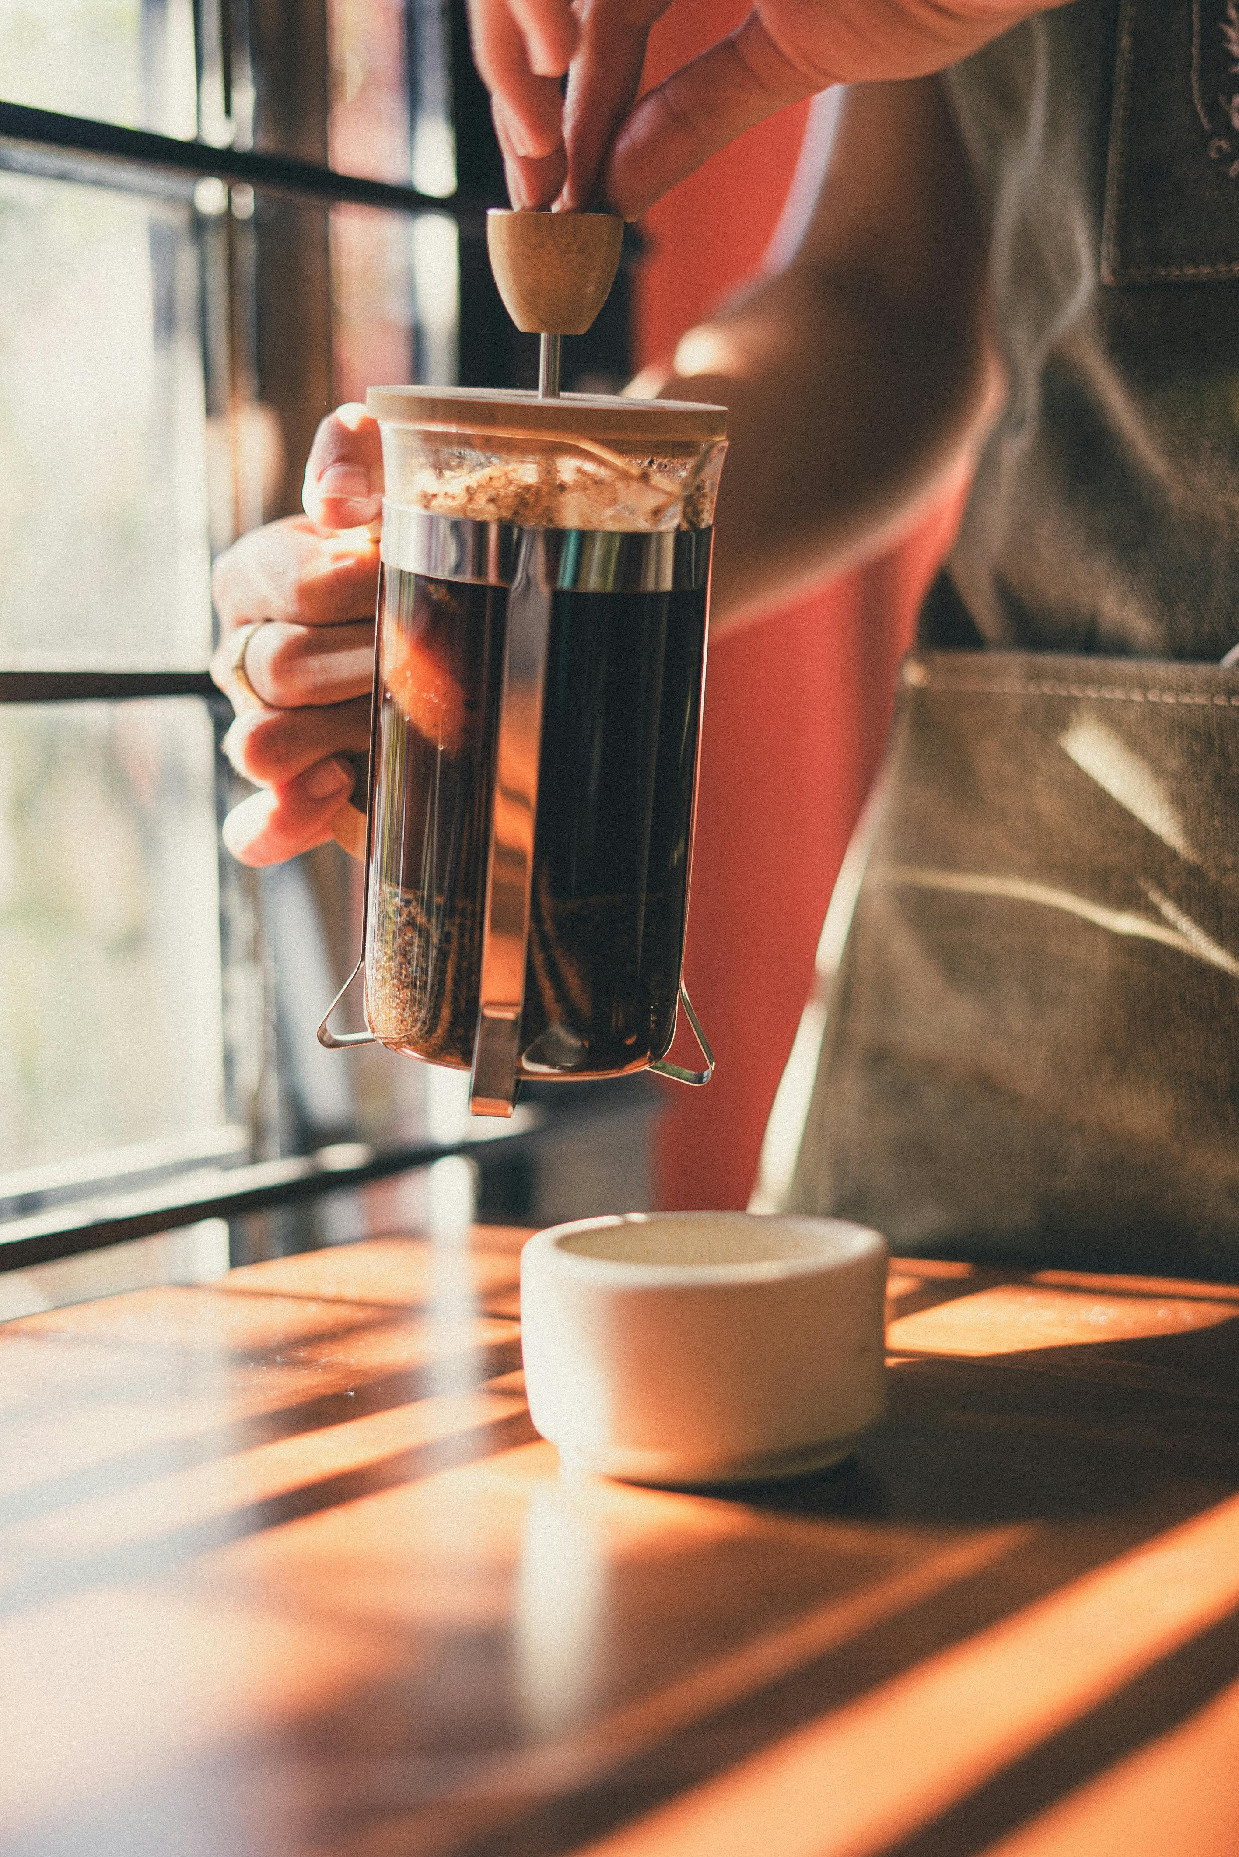

Brewing
Brewing = Controlled extraction of compounds
Coffee is 98-99% water
Two main methods:
Immersion
Percolation
Immersion vs Percolation?
Goal: Extract ”lagom”
Too little = Sour
Too much = Bitter
Taste and tweak!
Photo by Onur Kaya: https://www.pexels.com/photo/preparing-coffee-in-the-dripper-v60-15672165/
Photo by Los Muertos Crew: https://www.pexels.com/photo/photo-of-person-using-french-press-7488694/

Slide 55
Extraction
Acidic
Sour
Sharp
Time
Surface area (Grind, dose, water)
Agitation (Mix, stir, pour)
Temperature
Tasty Zone
Bitter
Astringent
Harsh
Extraction

Slide 56
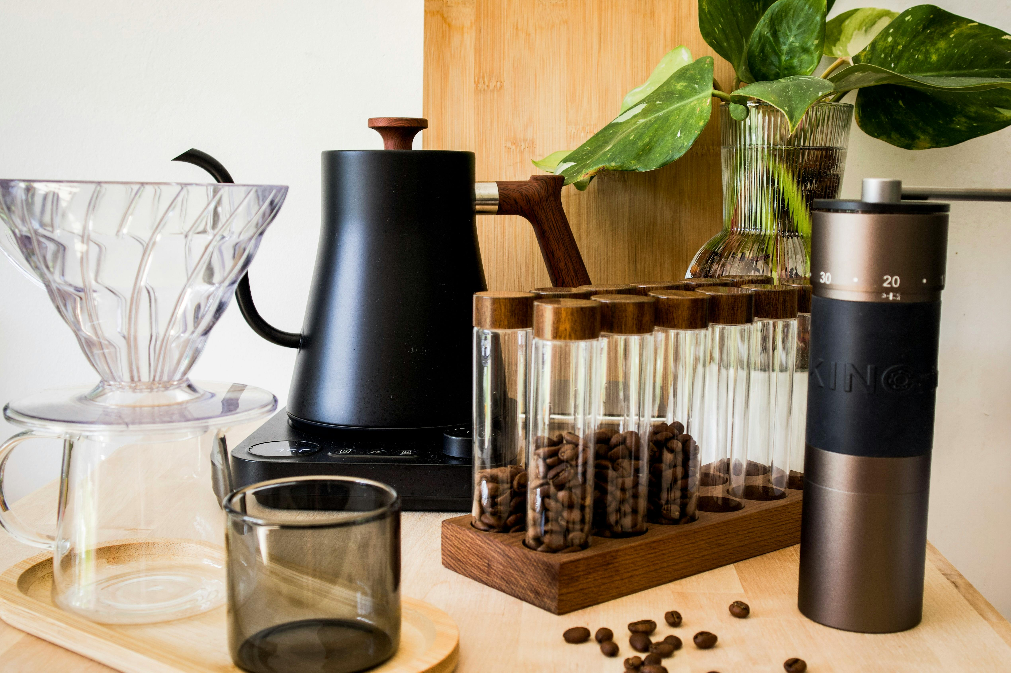
Recommended Equipment
Good specialty coffee beans
Grinder
Scale
Kettle
Brewing device
Hario V60
Aeropress
French Press
”Coffee maker” is fine
Filter(s)
Photo by Pascal: https://www.pexels.com/photo/modern-coffee-brewing-setup-with-accessories-32673615/

Slide 57
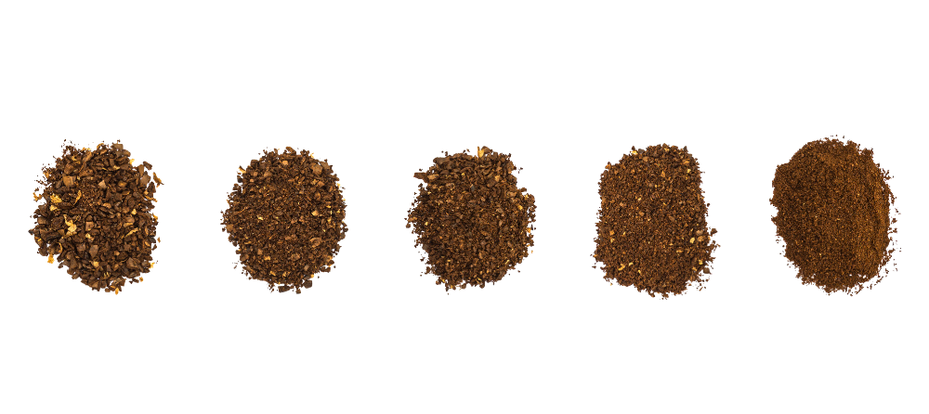
There’s a bunch more stuff we didn’t cover
Roaster types and profiles
Instant coffee
Decaffeination processes
Milk drinks
Grinders and particle size distribution
Espresso
Water and water minerals
Hand-brew Pouring technique
Paper filter differences
Other brewing devices
Brewing recipes
World Coffee Championships & others

Slide 58
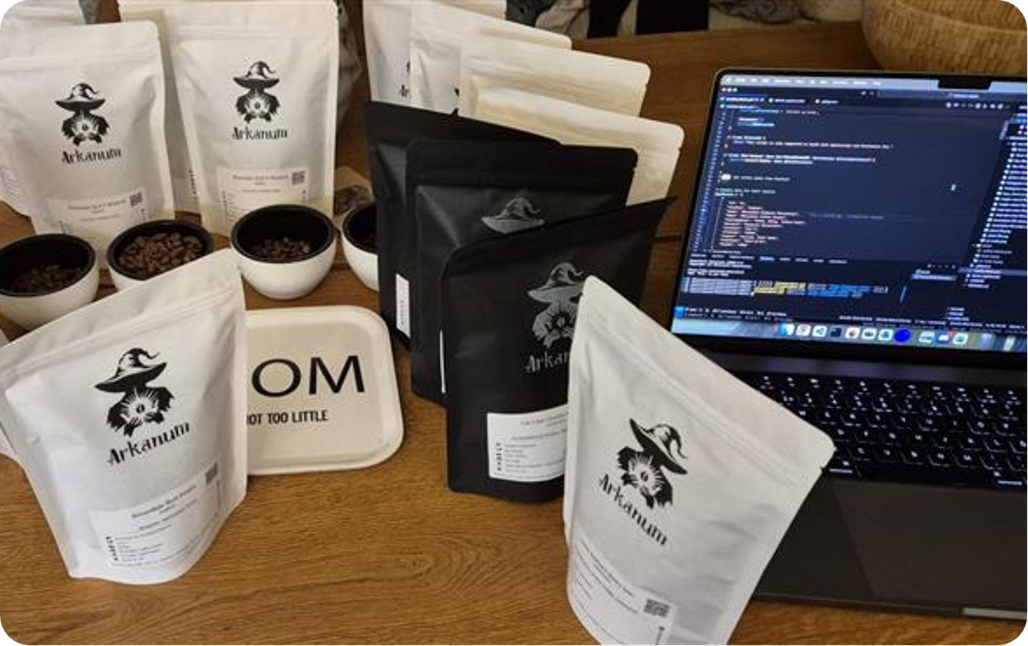
Live Brew + Q & A
Section
07
Photo: Me

Slide 59
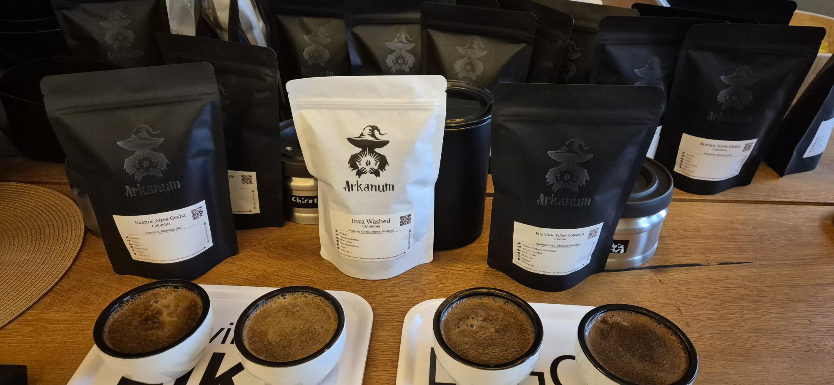
Pour Over Brew Recipe – 1 Liter
60g coarsely ground coffee / 940ml water
Brewer - Hario V60 03
5 Pours
92°C water
4~5min
Reset scale
Grind and add coffee (60g)
Pour 140g (200g)
Bloom 35~ seconds
Repeat 4 times:
Pour 200g
Wait 10~ seconds
Photo: Me

Slide 60

More?
Nordic Coffee Fest - Coffee Event in Gothenburg - https://www.nordiccoffeefest.com/
Roaster Kat - YouTube - https://www.youtube.com/@roasterkat
Making Coffee with Lucia Solis - Podcast - https://open.spotify.com/show/2LeX6OwWSFj4OHh5yqP3y0
Filter Stories - Coffee Documentaries - Podcast - https://open.spotify.com/show/070rR9RuQFQk4pz3fXbmCK
James Hoffman - YouTube - https://www.youtube.com/@jameshoffmann
How to Make the Best Coffee at Home – James Hoffman - Book
Lance Hedrick - YouTube - https://www.youtube.com/@LanceHedrick
The Physics of Filter Coffee - Jonathan Gagné – Book

Slide 61
Takeaways
Is it good coffee, and is the coffee good?
Beans, Grinder, Water
Brew Recipe
Reset scale
Grind and add coffee (60g)
Pour 140g (200g)
Bloom 35~ seconds
Repeat 4 times:
Pour 200g
Wait 10~ seconds
Brew Recipe 1 Liter
60g coffee / 940ml water
Brewer - Hario V60 03
Coarse grind
5 Pours
92°C water
4~5min
@PalmEmanuel

Slide 62
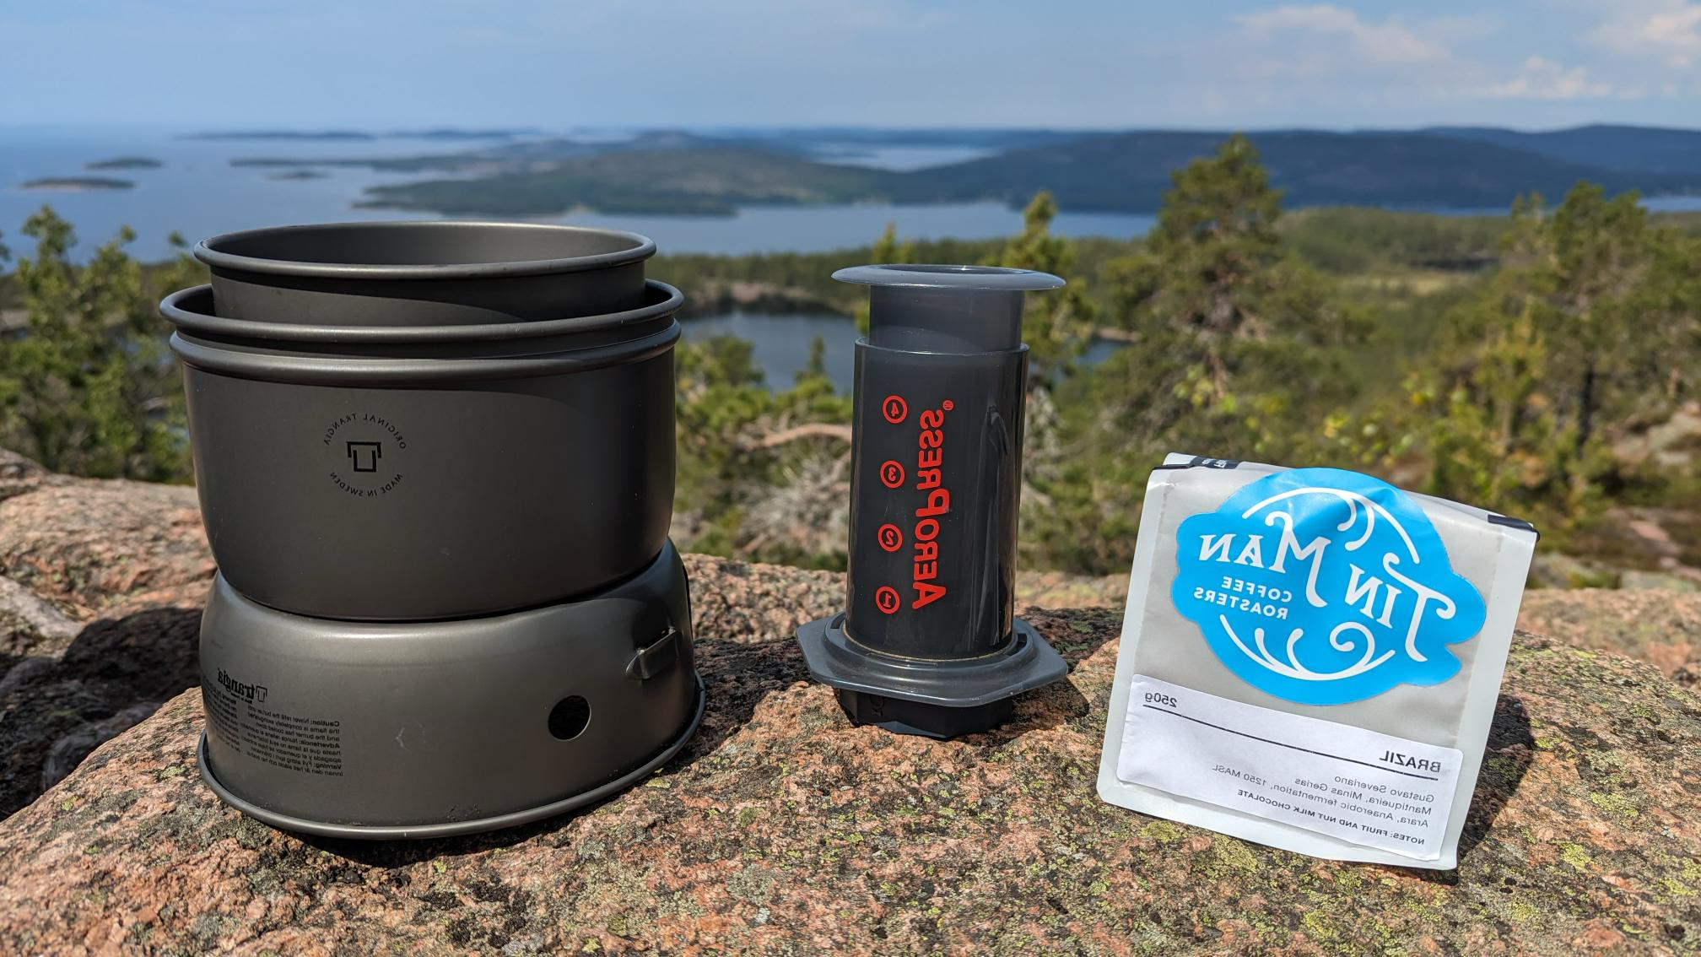


Thank you!
@PalmEmanuel
@arkanum.coffee

